Slide 1
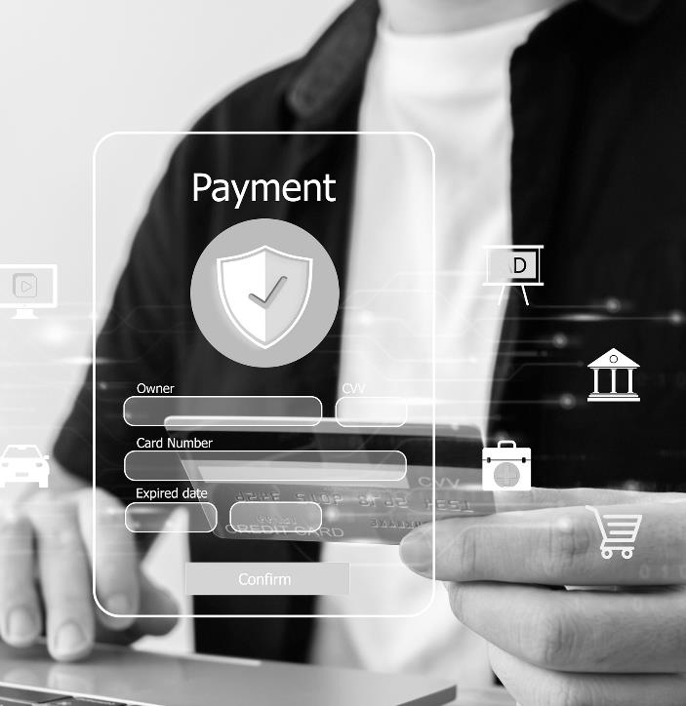

WELCOME
To The Ultimate Payments & Funds Disbursement
Solution

Slide 2


Founded in 1998
Nacha Certified & HIPPA Compliant
Highest Level of Security, Guaranteed
5 Star Customer Service, Verified!
Publicly Traded: Nasdaq: USIO
.
Usio, voted Top 25 Payments Technology Co., delivers a modular, scalable payments infrastructure designed to adapt to your business needs. Whether you’re a SaaS company looking to monetize payments, a government agency streamlining fund disbursements, or an enterprise managing high-volume print billing, Usio simplifies payments, accelerates revenue, and enhances the customer experience. With seamless integration and flexible payment solutions, Usio empowers businesses to scale effortlessly while optimizing cash flow.
ABOUT

Slide 3

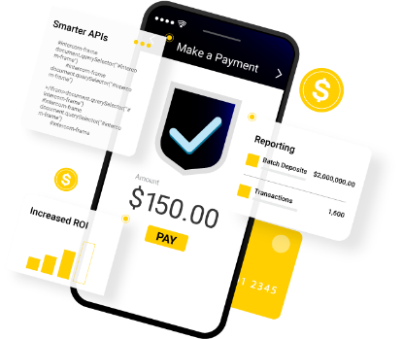
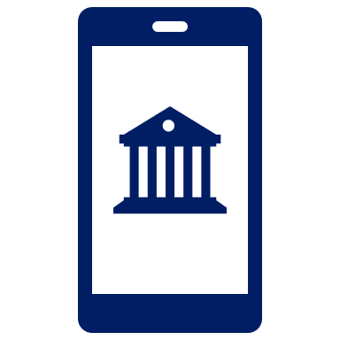


THE PLATFORM
Accept Payments
Integrate the following payment acceptance methods via a single Usio API: ACH, Card Processing, & Remotely Created Checks.
PayFac-as-a-Service: White-label Payment Facilitation without any of the risk. We do the work; you collect monthly residual checks with Usio revenue share.
Output Solutions
Bill print & mail invoices & checks with Usio Output solutions. Also includes Scan2Pay with QR codes, Electronic Bill Payments, Invoice Retrieval & hosting.
Disburse Funds
Send branded cards by mail or via mobile phone. Get even more control with MCC code restrictions. Compatible with Apple Pay®, Samsung Pay® & Google Pay™.
Push to debit cards, send to bank, send a check, send to PayPal, Venmo & more.

Slide 4







INTEGRATED PAYMENTS
Seamless, secure payments that maximize revenue and simplify transactions for businesses.
PAYFAC-AS-A-SERVICE
White-label payments, zero risk—Usio works, you earn monthly residuals!
ACH
Fast, secure ACH funding with Usio: Same/Next Day, fully compliant.
ACCEPT PAYMENTS
PINLESS
Fast, secure transactions 24/7 for seamless experiences and improved cash flow.
HOSTED PAYMENT PAGES
Secure, branded, & customized checkout with seamless integration and data protection.
TEXT2PAY
Instant payments via text—fast, secure, no apps, no hassle!
At Usio, we offer more than just card processing—we provide 5-Star Support that connects you with your customers, safeguards every transaction, and drives efficiency to help your business thrive.
RCC
Skip ACH delays! Remotely Created Checks offer fast, secure payments anytime.
BUY NOW PAY LATER
Boost sales! Buy Now, Pay Later offers flexible, stress-free payments.

Slide 5







No Integration Fees – No hidden costs, just
a cost-effective solutions.
Transparent Revenue Share – Know exactly
what you’ll earn with our competitive model.
Own Our Technology – Full control, reliability, and faster updates—no third-party blame & reliance.
Built-in Compliance – PCI-DSS, AML, and
KYC included; no extra services needed.
All-in-One Payments & Disbursements – One platform, no need for multiple providers.
Customizable & Automated – Tailored
solutions with seamless onboarding.
5-Star Customer Support – Real help, real
fast, from a knowledgeable team
PAYFAC-AS-A-SERVICE
We turn payments into profit! Get all of the value of being a Payment Facilitator without the cost, risk, or downtime while earning additional revenue.

Slide 6

 | TILLED | STAX | PAYRIX | NMI | STRIPE | USIO
API- First Approach
No Set-up, or Monthly Integration Fee
Transparent Revenue Share
Own their technology (no outsourcing)
Built-in PCI-DSS, AML, and KYC
Loaded Payments & Disbursement Platform
Customizable
Automated On-Boarding
5 Star Customer Support
PAYFAC-AS-A-SERVICE
^{Competitor Analysis}

Slide 7
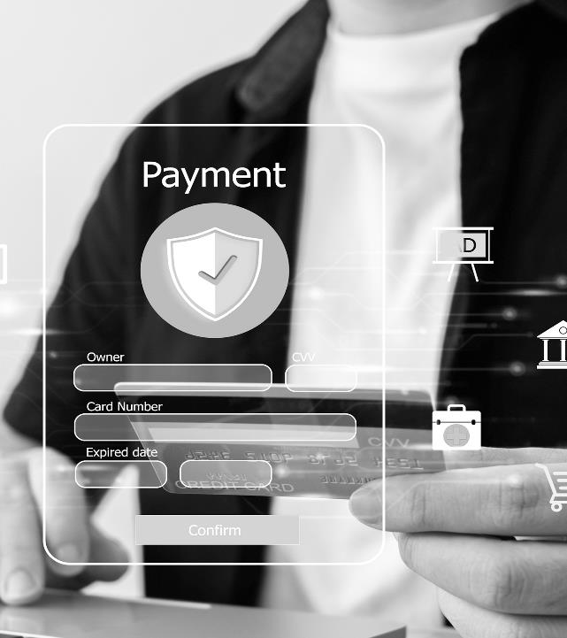







^{Reporting & Reconciliation}
^{Automated On-boarding}
^{Card Updater}
^{Recurring Payments}
^{Split Payments}
^{EMV Terminals}
^{No Integration Fee}
^{Prenotes}
Account Validation & Verification
ADDITIONAL FEATURES

Slide 8















BEST USE CASE BY VERTICAL
CASE
STUDIES
Healthcare Tech CRMs, ISVs, EHR
^{Non-Profit Tech CRMs}
^{Utilities Tech}
^{Field Services Tech}
^{Property Management Tech}
^{Insurance Tech}
^{Legal Tech}
^{FinTech}
^{Many Other B2B SaaS}
PayFac-as-a-Service First Approach
2024
Processing Volumes $59M
No. Transactions 490K
Total Accounts On-boarded 372
Annual Revenue Share $233K
2024
Processing Volumes $13.2M
No. Transactions 244K
Total Accounts On-boarded 533
Annual Revenue Share $104K
2024
Processing Volumes $79.1M
No. Transactions 260K
Total Accounts On-boarded 441
Annual Revenue Share $453.2K
TESTAMONIAL
TESTAMONIAL
SUCCESS STORY

Slide 9

USIO CARD ISSUING
Powerful branded card issuing—physical or virtual. Control MCC codes, enable ATM access, bank transfers, and seamless delivery by mail or mobile.
SEND TO BANK
Fast, secure ACH transfers—same-day or next-day. Nacha Certified Third Party for seamless bank deposits.
PUSH TO DEBIT CARD
Instantly send funds to any debit card, 24/7—fast, seamless, and convenient.
DISBURSE FUNDS
SEND REAL TIME
Send real-time payments instantly—faster than ACH, safer, and with real-time reconciliation for seamless, secure transactions anytime.
SEND TO ATM
Send funds directly to ATMs for instant, secure cash access—fast, convenient, and reliable for recipients anytime, anywhere.
PAYPAL & VENMO
Send funds instantly to PayPal and Venmo, 24/7. Enjoy global reach, seamless transfers, and fast, secure transactions anytime, anywhere.
Sends funds to anyone, anytime, anywhere—backed by 5 Star Support and the highest level of
security every step of the way.
SEND CHECKS
Send checks effortlessly with Usio trusted print and mail service—over 25 million checks and invoices processed securely and reliably.

Slide 10
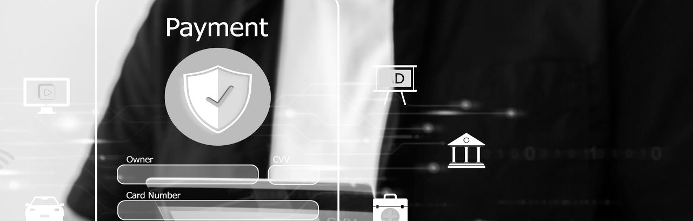
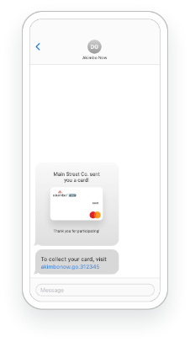
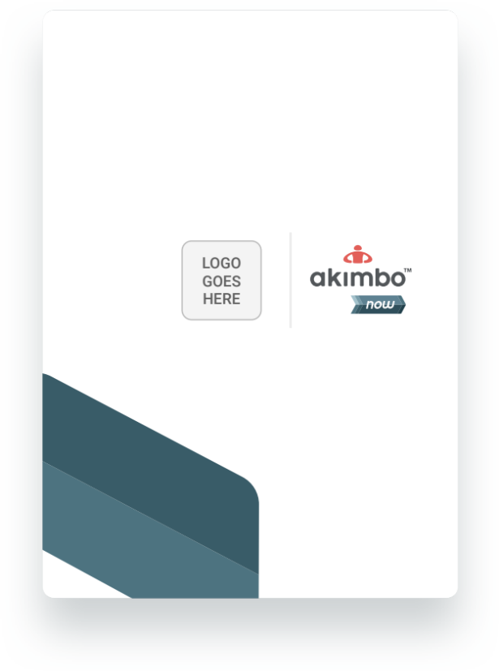
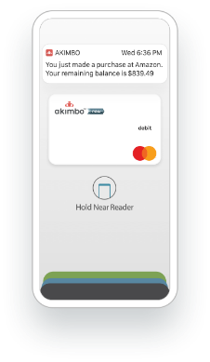
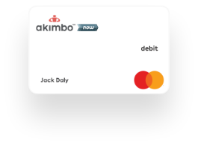
PHYSICAL CARDS
Web and mobile access, plus SMS transaction alerts
Ship to any address in the US or order in bulk
Send anonymous or unregistered
VIRTUAL CARDS
Send funds to email or mobile
Provision virtual card to Apple, Google or Samsung Wallets
Use for online purchases
Convert to physical card
CARD ISSUING

Slide 11
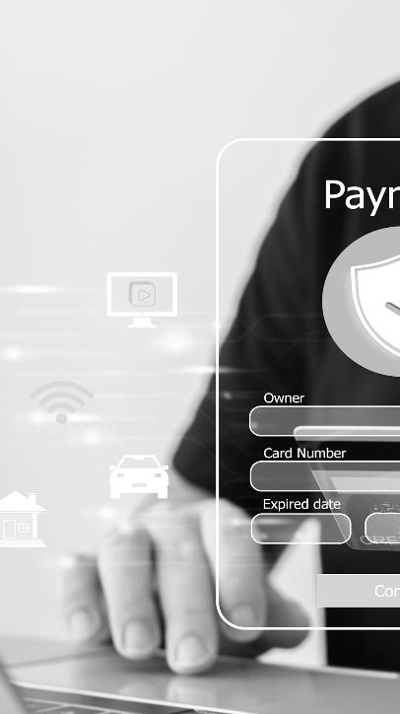

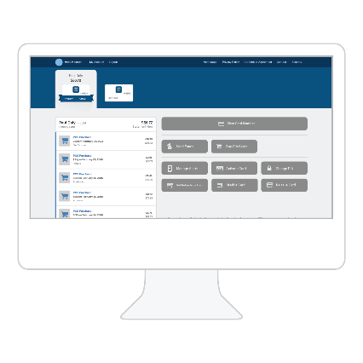
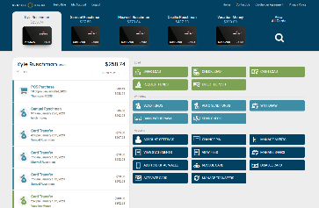



01
Creating & Loading Cards
Batch file via SFTP
Web services API
Contact client representative
Dual Interface/Contactless
Customizations
Branded card and card package
Anonymous or KYC-required cards
ATM access (enabled/disabled)
Merchant Category Code (MCC) restrictions
Branded web and mobile apps
Cardholder Features
Online and mobile access
Real-time SMS transaction alerts (purchases and loads)
Live agent customer service
ADDITIONAL FEATURES
^{CARD ISSUING!}
Sends funds to a highest level of
security every step of the way.
02
03

Slide 12






BEST USE CASES
^{Card Issuers}
^{Disbursement Tech}
^{Municipalities & Government}
^{FinTech}
^{Non-Profits}
Medical Insurance Disbursements
^{Many other Businesses}
CASE
STUDIES
Card Issuing Solution First Approach
2024
Cards Issued
Volume
2024
Cards Issued 1000
Volume $11,997.00
2024
Cards Issued
Volume
TESTAMONIAL
TESTAMONIAL
SUCCESS STORY

Slide 13



BILL & CHECK
PRINT & MAIL
BILL PRINTING
Full-service printing—from design to delivery—saving you time and money while ensuring professional, accurate statements reach customers on time.
MAILING
100% MRDF Validation Accuracy – Every envelope matches the correct statement, bill, invoice and other documents.
SCAN2PAY
Increase payments received on time by 30% or more with QR codes. Customers simple Scan2Pay.
Whether you’re looking to optimize digital presentment, securely store records, or manage the complexity of printing and mailing services, we have the expertise to elevate your operations. Discover how our solutions will enhance your customer experience, boost efficiency, and reduce operational costs.
eBILLING
Discover how our solutions will enhance your customer experience, boost efficiency, and reduce operational costs.
DOCUMENT WAREHOUSE
Store, secure, and instantly access billing records for audits, compliance, and customer inquiries—ensuring long-term retention and peace of mind.
CHECKS
Send checks effortlessly with Usio trusted print and mail service—over 25 million checks processed securely and reliably.

Slide 14

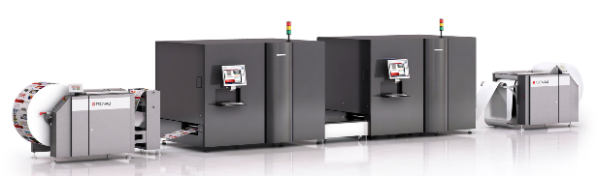
TECHNOLOGY
BILL PRINTING
Full-color, all digital, variable printing at 73,000+ images per hour.
Each roll of paper is approximately 90,000 feet (17 miles)
No preprinted forms are needed
Never billed for spoilage

Slide 15

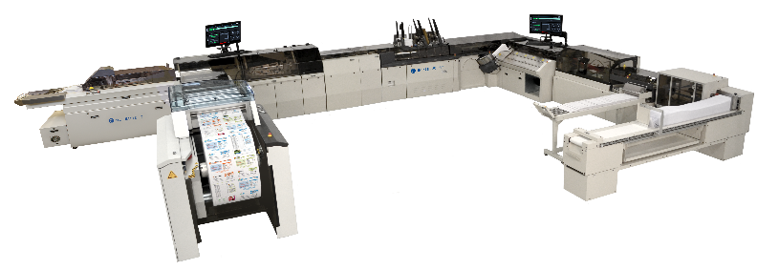
MAILING & INSERTING
TECHNOLOGY
72,000 sheets/hour
384,000 pieces/day
Real time piece level tracking
100% validation

Slide 16

100% Validation
MRDF technology is the index file that we feed to the inserter that comes from the print image file. It ensures every single sheet of paper into an envelope. The file delivers data about what the insertion equipment should expect and looks to match each piece for 100% validation.
With this solution in place, it allows us to be accurate and reliable.
Sends funds to a highest level of
security every step of the way.
MRDF
MAIL RUN DATA FILE

Slide 17

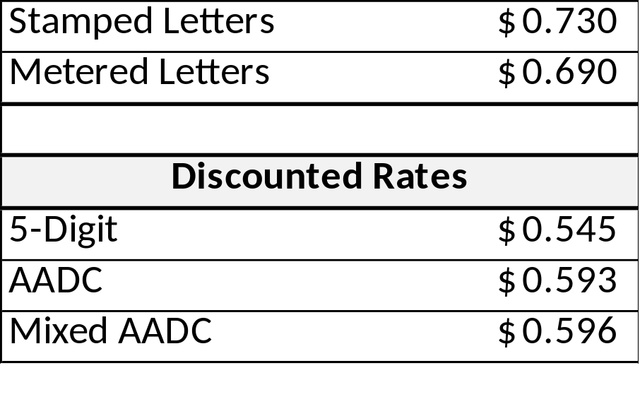
POSTAGE DISCOUNTS
Usio presorts and passes through all postage discounts* This reduces cost and mail delivery time. *500 or more pieces are needed to qualify for postage discounts

Slide 18

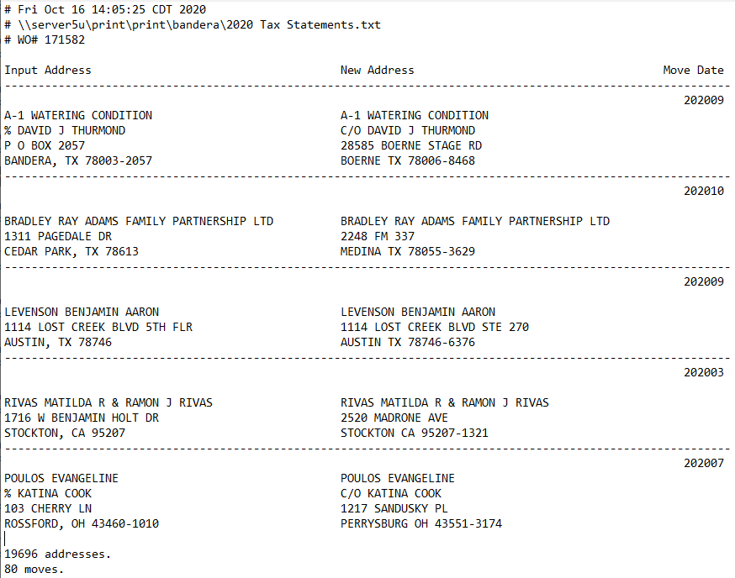


NCOA
NATIONAL CHANGE OF ADDRESS
Americans are on the move. More than 40 million Americans move every year, changing their addresses in the process.
NCOA processing validates names and compares them to the USPS change of address database.
Usio updates and mails to the new address on file and a report is returned to the client.
Sends funds to a highest level of
security every step of the way.
SAMPLE REPORT

Slide 19
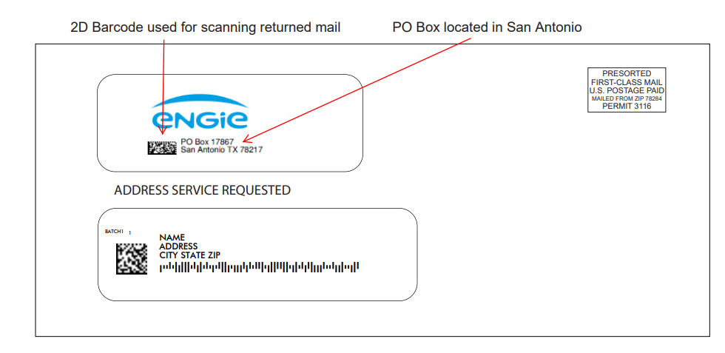
RETURN MAIL
PROCESSING
Local PO Box: A secure, professional address for incoming mail.
Barcode Tracking: Unique barcodes ensure seamless tracking.
Custom Data: Barcodes include key details like account and check numbers.
Secure Disposal: Scanned documents are safely destroyed or returned.
Streamline Your Mail Processing with End-to-End Secure Solution!
Get unmatched efficiency, security, and customization—all while eliminating the hassle of managing your incoming mail. Let us handle it while you focus on what matters most!

Slide 20



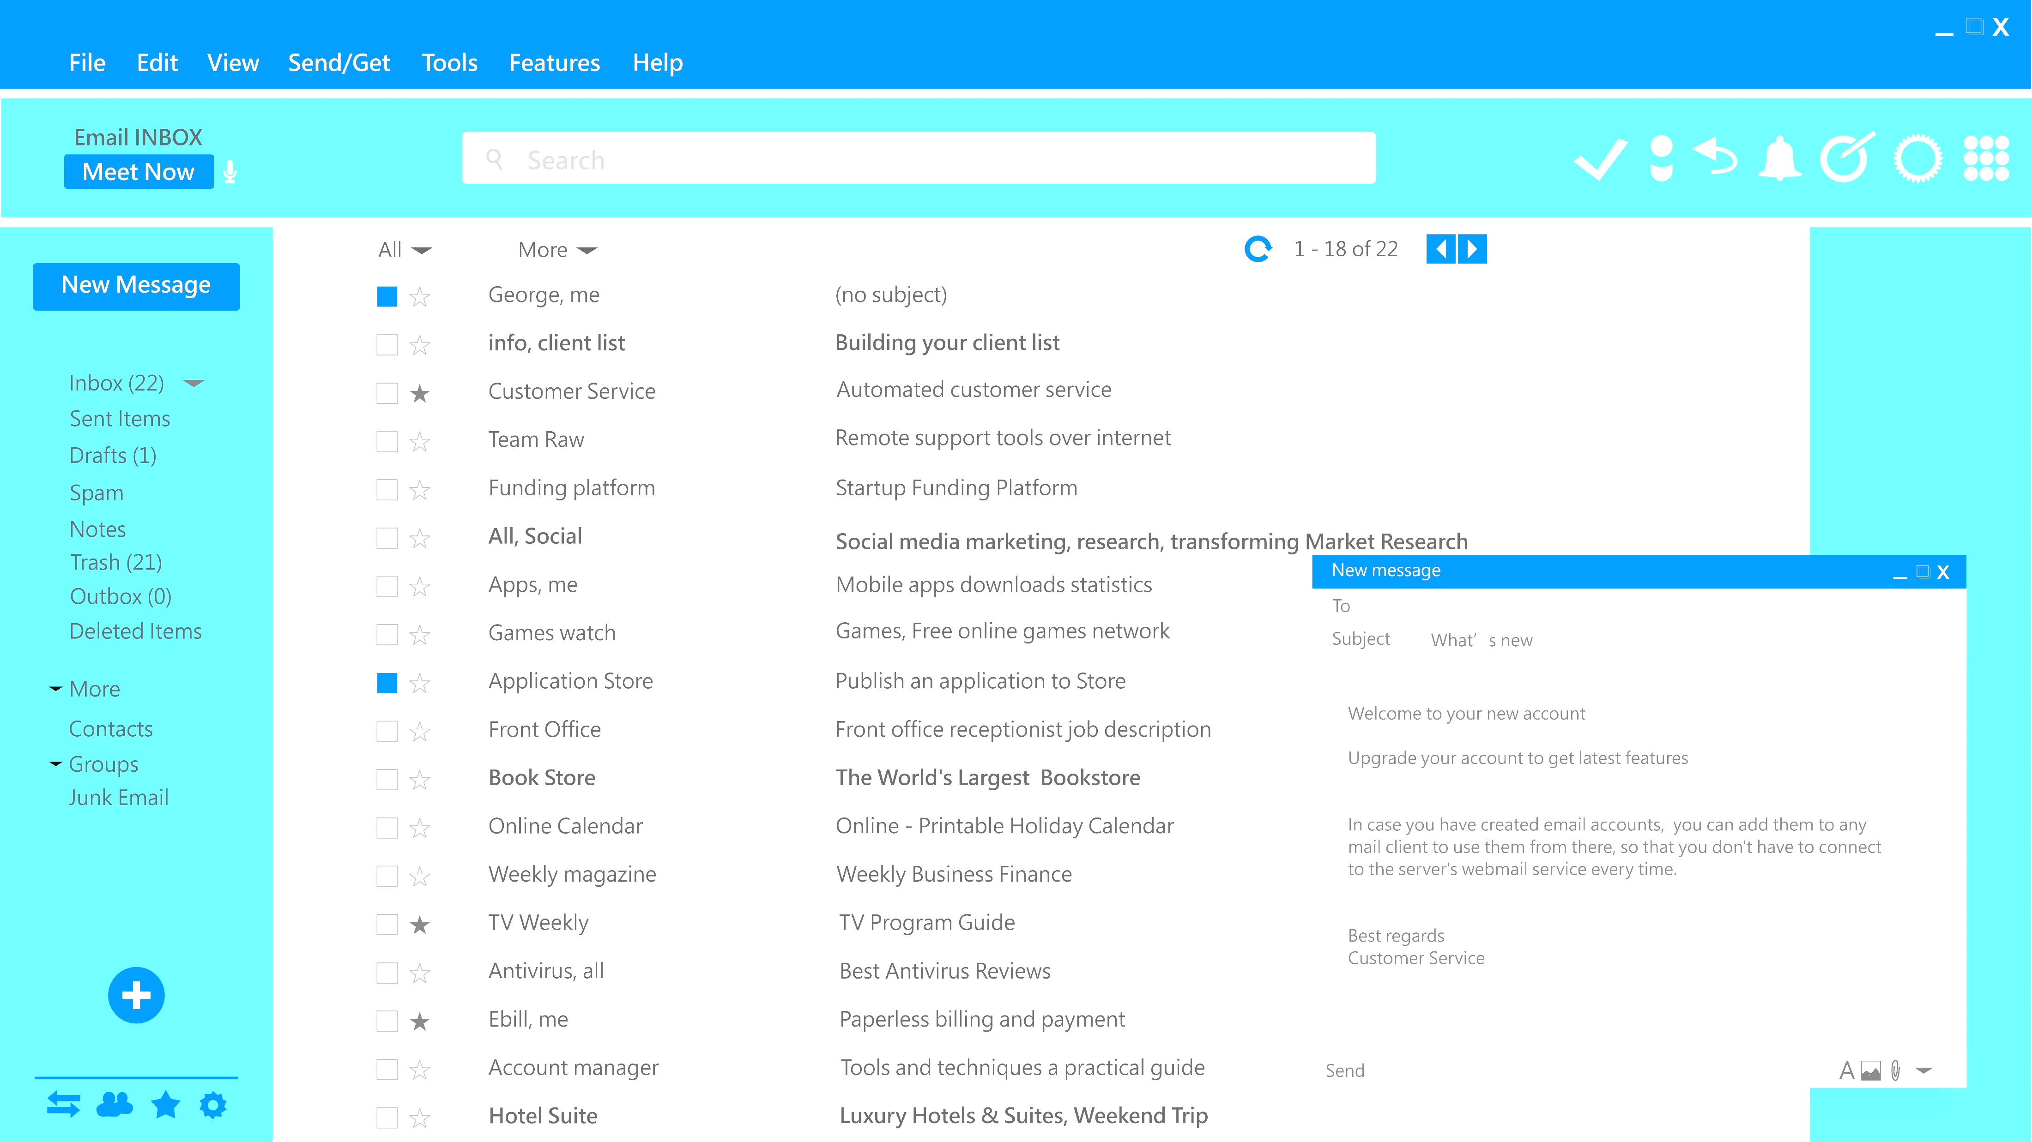

Faster Payments: Reduce Date Sales Outstanding by 10 days with immediate digital delivery.
Lower Costs: Save 50-70% on paper and postage
Increased Engagement: eBill emails have a 60-80% open rate
It’s fast, seamless, and drives results
Getting started with Usio is a breeze! We’ll automatically generate, and email branded PDF statements directly to your customers. Plus, you can customize the email content to include a secure payment link for quick, one-click payments and even add text to promote services or upsell new offerings.
eBILL
Higher Payment Rate: 30-45% of customers pay sooner
Reduce carbon footprint by 80%.

Slide 21
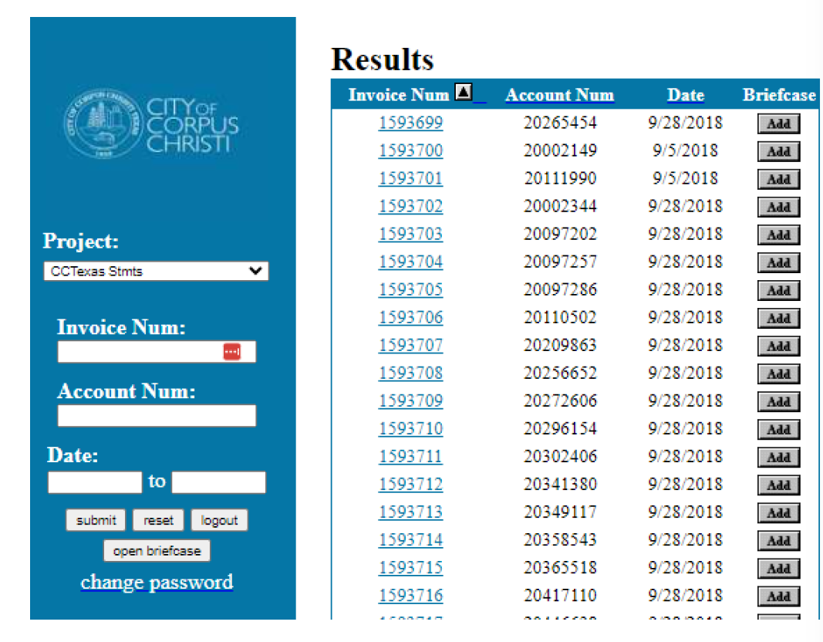
DOCUMENT
RETRIVAL &
HOSTING
Easy, Fast & Secure
Easly store, access, retrieve documents as needed. Search by Invoice Number, Account Number, by Date and more.

Slide 22
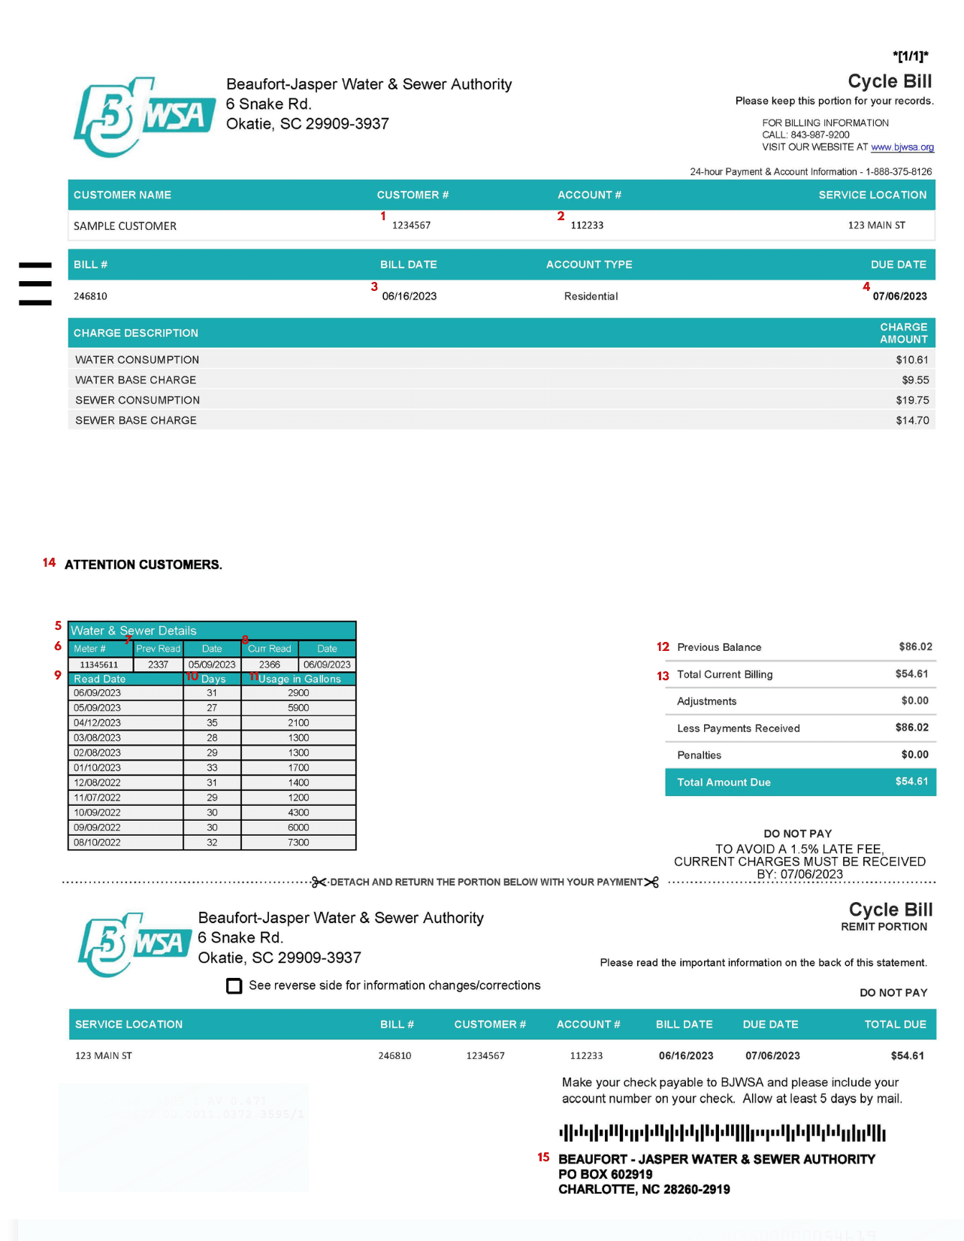

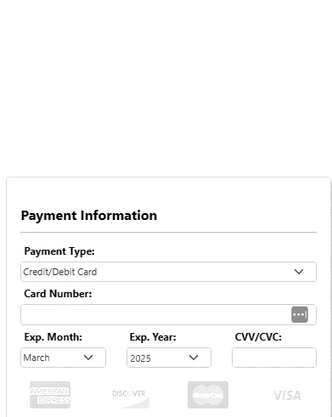

SCAN 2PAY
PAY BY
Card, ACH,
Remotely Created Checks
Increase payments received on time by 30%
SCAN
2PAY

Slide 23
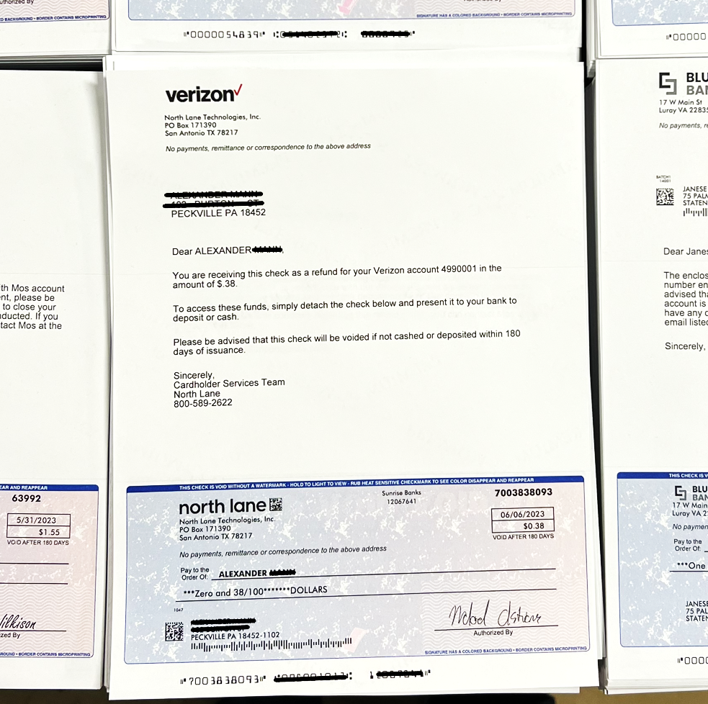
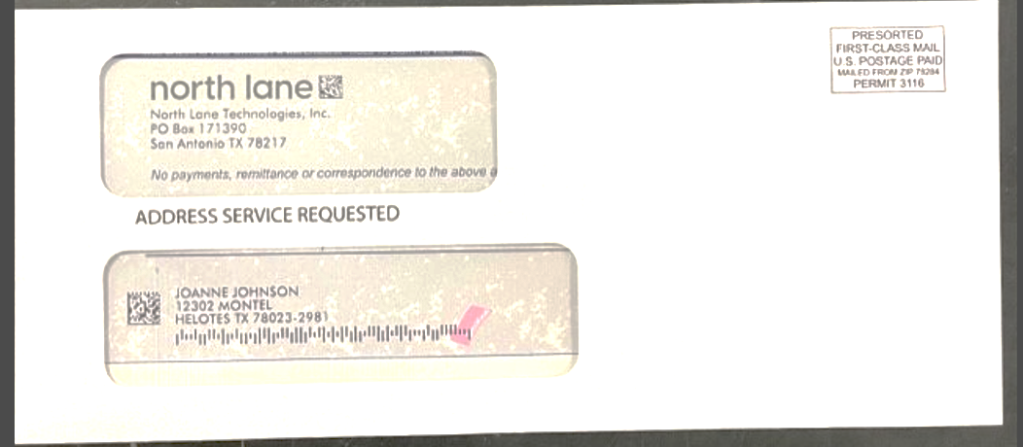
01
FORMATS
We produce checks from multiple file formats, however Tab Separated is preferred. Other acceptable formats are Excel, Fixed Width & Comma-Separated
DATA NEEDED
Account Number, Routing Number, Check Number, Check Date (this can also be hard-coded), Check Amount, Payee Name, Payee Mailing Address City, State, and Zip
OTHER ITEMS NEEDED
Logo, Return address, Detail/Letter for the top 2/3rds of the check, & Signature for check
CHECK
PRINTING & MAILING
All checks are securely stored in a restricted access area, protected by coded entry systems to ensure maximum security.
Sends funds to a highest level of
security every step of the way.
02
03

Slide 24
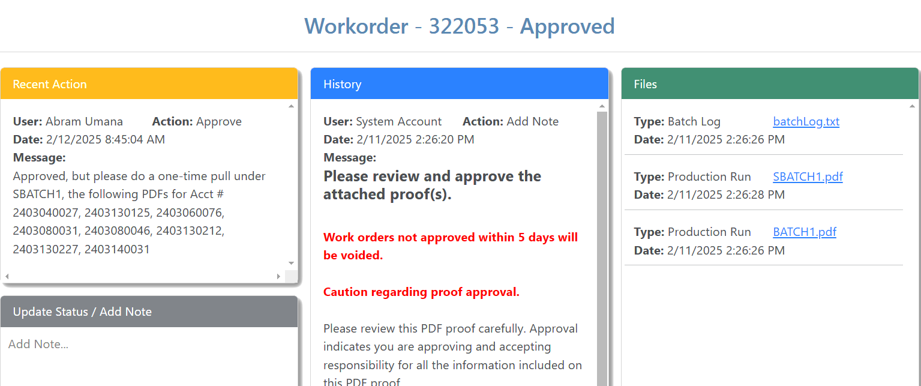
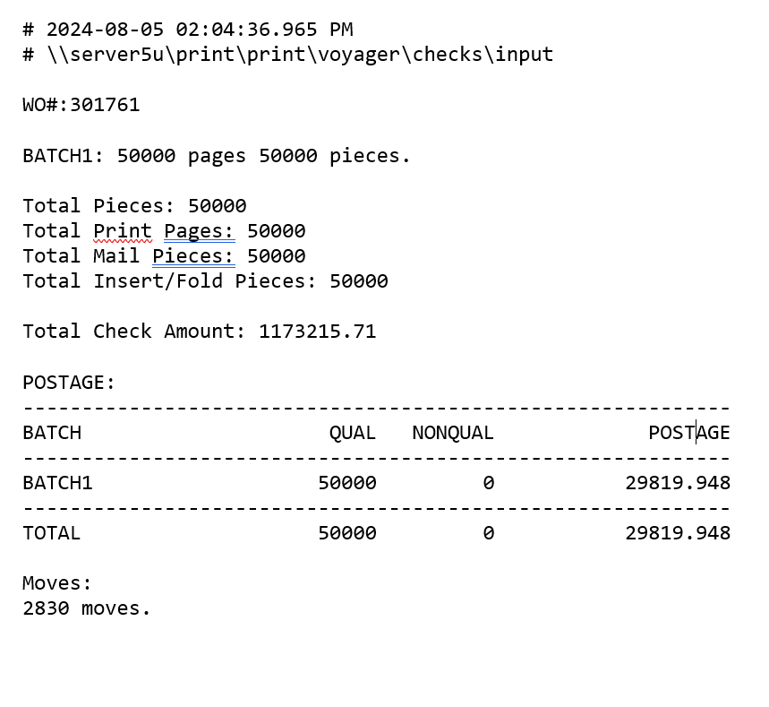
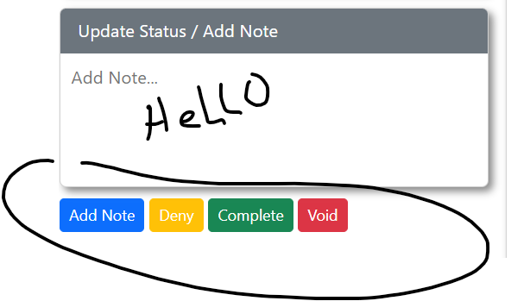
REPORTING
Print, Mail, eBill, & Scan2Pay

Slide 25
25.5M
Invoices & Checks Processed
Sends funds to a highest level of
security every step of the way.
37M
BY THE NUMBERS
Electronic Invoices Processed
^{Print, Mail & eBill}
100%
Mail Run Data File Accuracy

Slide 26





BEST USE CASES
^{Utilities}
^{Banks}
^{Municipalities & Government}
^{Energy Companies}
^{Non-Profits}
^{Medical & Insurance}
^{Many other Businesses}
COM
MENTS
^{Print & Mail}
“Another perk is the assistance at Usio. They’re great partners & helpful from the beginning to the end.”
“Usio is one of our most reliable vendors. They assist with all requests allowing us to better serve our customers”
“Usio provides high volume printing, inserts and production reports daily. Their personnel is available anytime providing special attention and fast service”

