Slide 1


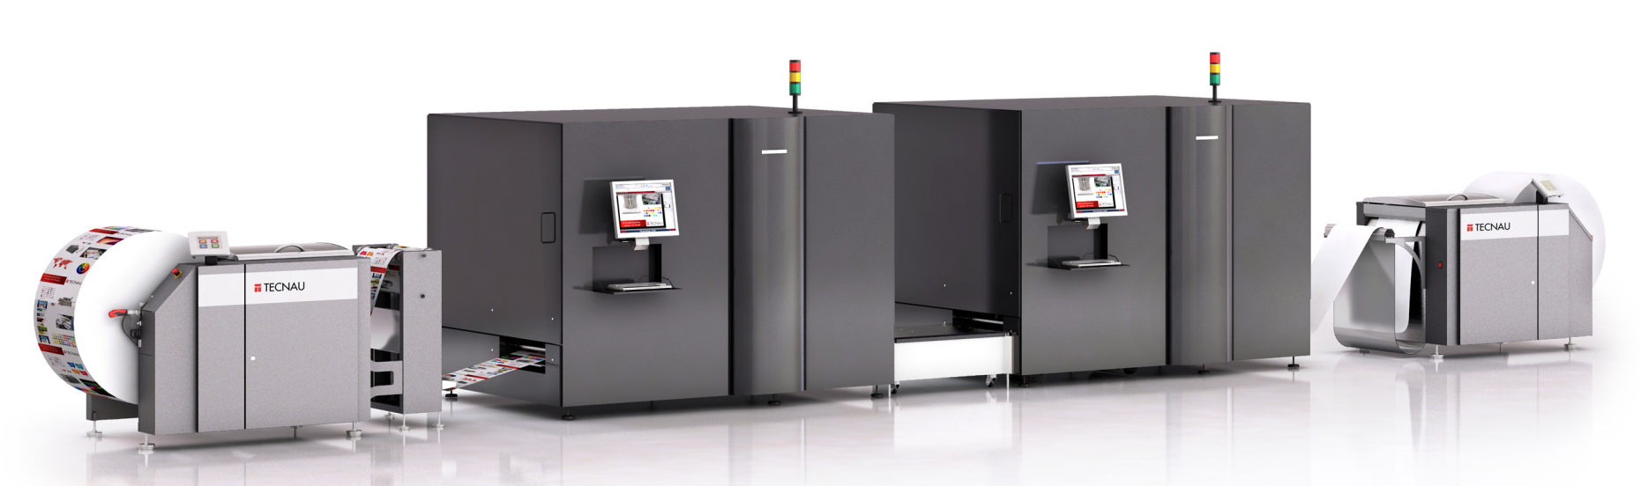
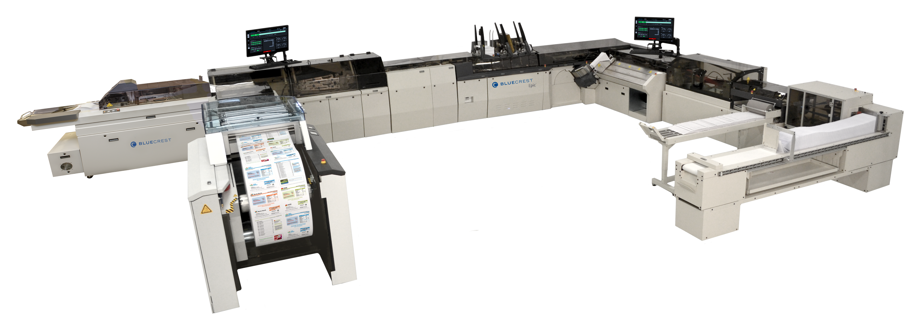
Output Solutions Equipment
Roll to roll high-speed printing and inserting
Full-color, all digital, variable printing at 73,000+ images per hour.
Each roll of paper is approximately 90,000 feet (17 miles)
Inserting up to 72,000 sheets/hour, 384,000 pieces/day.
Real time piece level tracking for 100% validation.
Nasdaq: USIO
usio.com

