Slide 1



Card Issuing
Prepaid Card Issuance & Program Management Solutions
in partnership with

Slide 2



Open-Loop – Network branded debit cards (used anywhere Mastercard, Visa, AmEx, or Discover is accepted).
Restricted Authorization Network (RAN) – Network branded cards that can be restricted by MCC’s or MID’s.
        *Close-Loop – Cards only used at designated merchant locations (Usio does not support). Close-Loop cards are very costly to get set up initially, integration in required for online and physical POS locations, and cards only work with closed loop processors.
Open-Loop Cards – can be loaded one-time (Consumer Gift Cards – Domestic Usage Only) or reloadable (Examples Include: Incentive/Disbursement, General Purpose Reloadable (GPR), Promotional, or Corporate Expense cards – International Usage Available)
Usio/FiCentive offers all of the following services: Program Management, Card Operations, Issuer Processing, Web and Mobile Applications, Customer Service, Fraud and Dispute Management
Usio is one of the few remaining companies that offer full stack issuer processing and program management services in the FinTech space. We own and operate 2 of the 3 legs of the stool and Sunrise Banks is our current sponsor bank servicing each of our 4 BINs.

Slide 3
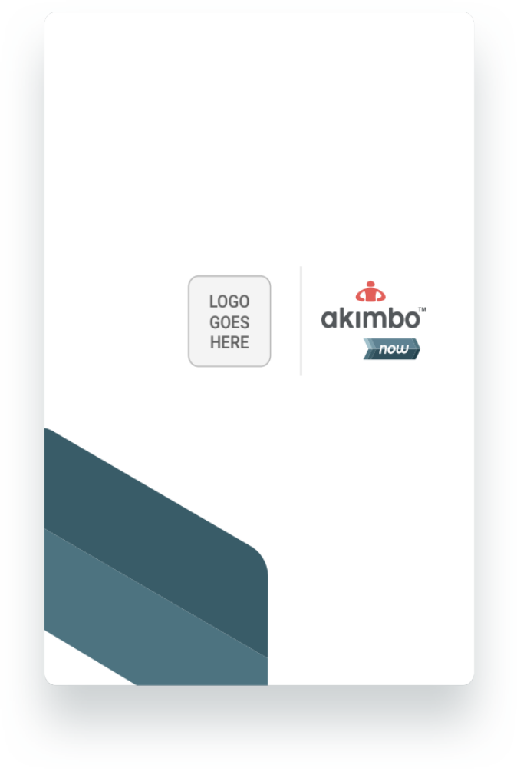
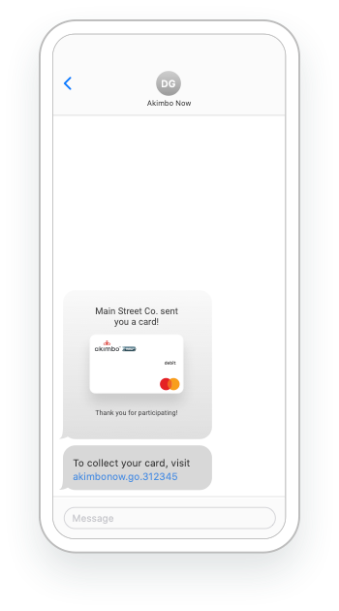
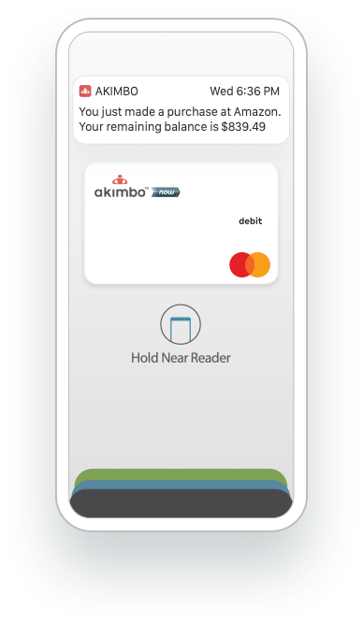
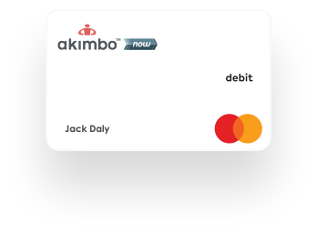
Card Issuance and Money Disbursement
Services:
Debit Mastercard Issuance (Physical)
Virtual Mastercard Issuance
Other Disbursement Services (Consumer Choice):
ACH Processing
Push to Debit Card Payments
Paper Checks
Venmo/PayPal
PIN 4 (cash pick up)
Use Cases:
Emergency Relief Assistance
Corporate Expense Management
General Funds Disbursement
Contractor/Gig Payouts
Incentives and Promotions
Payroll Cards (coming soon)

Slide 4
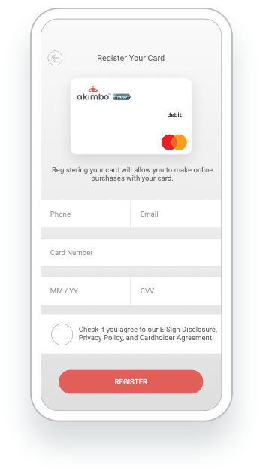
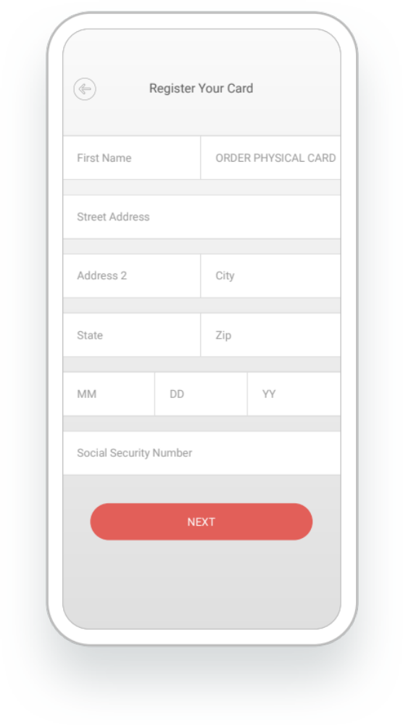
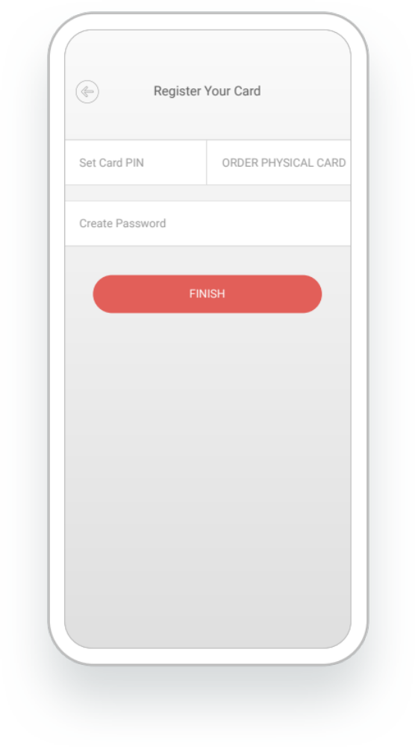
Anonymous vs Registration Required
Anonymous (No Registration Required)
Cards that do not require registration can only be loaded by a sponsor organization and used by the cardholder for purchases, however there are some restrictions:
$15,000 Max Balance (no loading limits)
No Consumer Loads (e.g. direct deposit, cash loading)
Registration Required
Cards that require registration (KYC/Know-Your-Customer) provide additional access and increased limits:
$ 15,000 Max Balance
Consumer Loads Permitted (e.g. direct deposit, cash loading)
Registration can be completed in a few short steps online with a mobile phone or PC. The cardholder must provide certain identifying information, including:
Social Security Number (SSN)
Date of Birth (DOB)
Foreign Passport or ID (if no SSN/cardholder is not a U.S. Citizen)

Slide 5
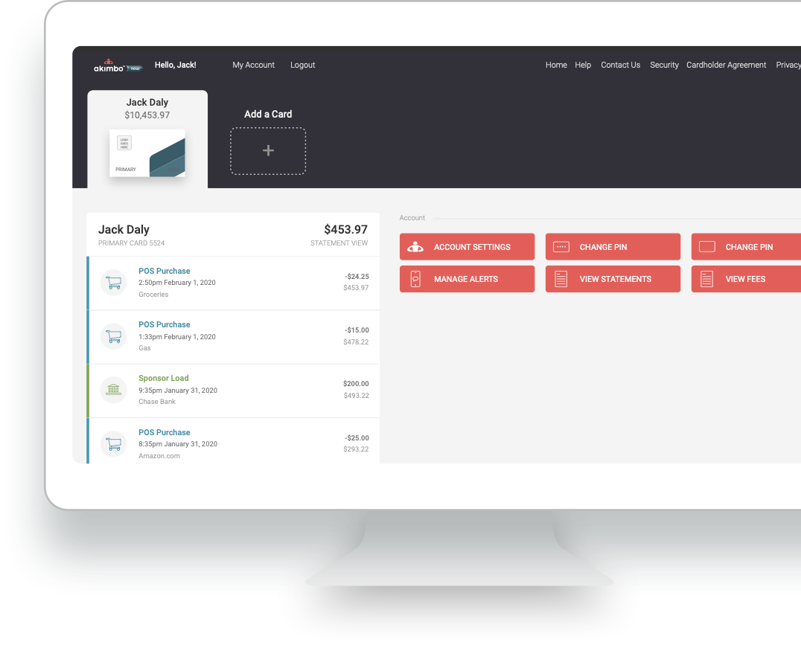
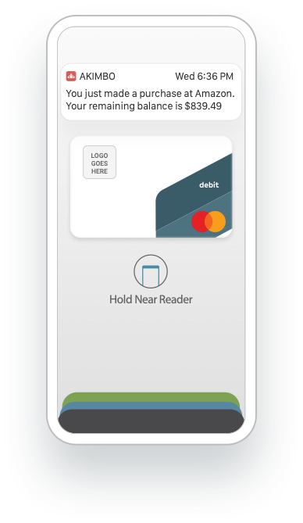
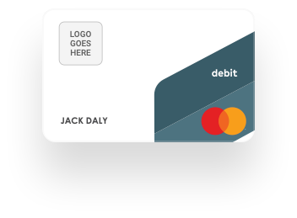
Options and Features
Creating and Loading Cards
Batch file via SFTP
Webservices API
Contact client representative
UCP (Ultimate Card Platform) coming soon!
Card Program Customizations
Branded card and card package
Anonymous or KYC-required cards*
ATM access (enabled/disabled)
MCC and MID restrictions
Branded web and mobile apps
Cardholder Features
Online and mobile access
Real-time SMS transaction alerts (purchases and loads)
Freeze card if lost or stolen
Live agent customer service (Bilingual)
* Anonymous cards can be funded by organization only (not by cardholder) and have $15,000 max balance restriction.

Slide 6



































Trusted by top organizations, nonprofits, government agencies
to receive and disburse funds

Slide 7

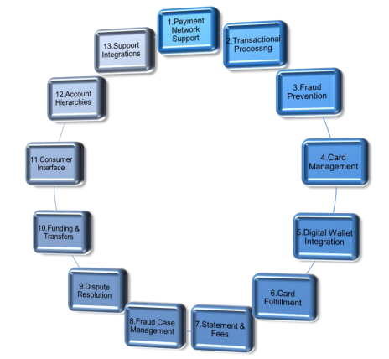
Why Usio?
Usio provides all 13 key points as a preferred issuer processor and program manager

Slide 8
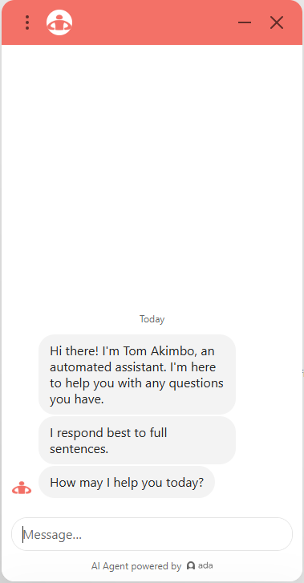
Multi-channel customer service:
Customer Support
Support AI Agent
Cardholder website help pages: https://help.akimbocard.com/hc/en-us
Telephone, Interactive Voice Response (IVR) services, providing cardholders the ability to activate a card and retrieve their card balance 24/7
Live agent telephone support, based in the U.S. available Monday through Friday between 7am and 7pm, Central Standard Time, excluding bank holidays. Ubiquity Global Services is available for additional agents if needed.
Live chat support and AI Agent
Email customer support
Reg E-compliant dispute handling for all cardholder-initiated transaction disputes
Language translations services via TransPerfect Connect for over 170 different languages (see List on following slide)

Slide 9
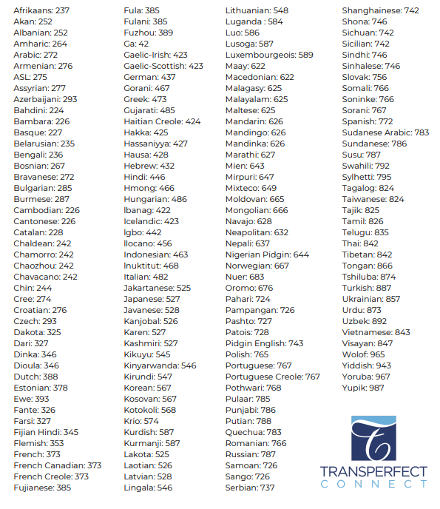
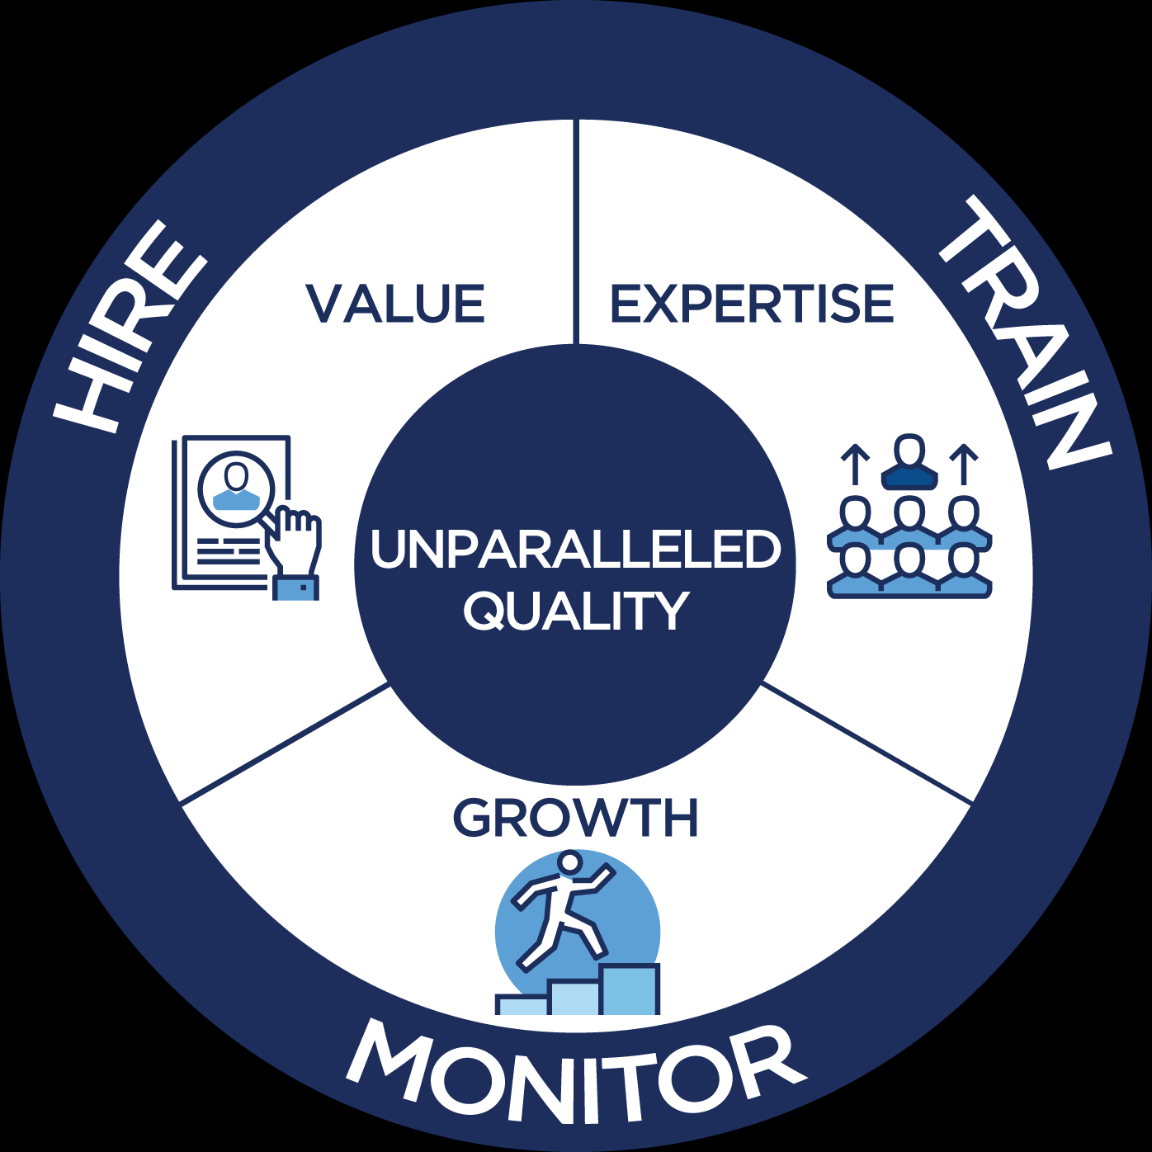
Customer Support

Slide 10



Benefits of Prepaid
Reducecost
Increase revenue
Streamline processes
Strengthen security
Control of spending Data and reporting

Slide 11
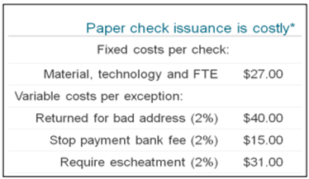
Business Benefits | Shifting Checks to Prepaid
Expedited payments with real-time card loads and disbursements
Increases brand recognition and loyalty
Reduces the administrative burden of managing paper check and refunds
Eases reconciliation process and improves employee productivity
Saves your business a lot of time and money…

Slide 12
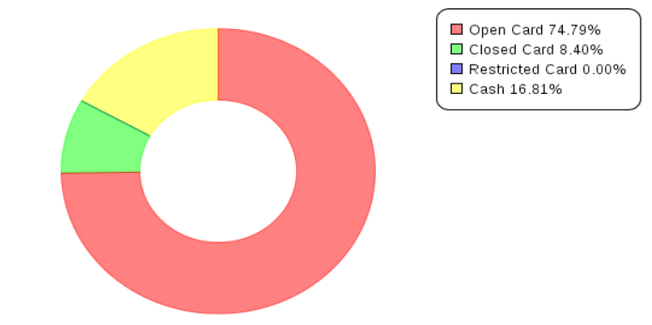
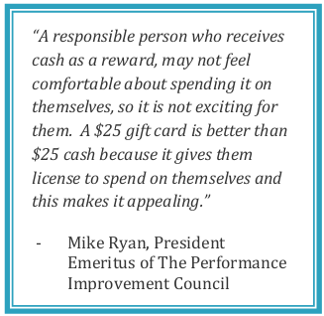
Consumer Benefits | Preferred Payment Type
Ability to receive immediate payments
Safer and more secure than cash
Access to funds at millions of locations that accept MasterCard ® or Visa®
Key motivator for rewards & incentives; 75% of consumers prefer
open-loop prepaid cards

Slide 13
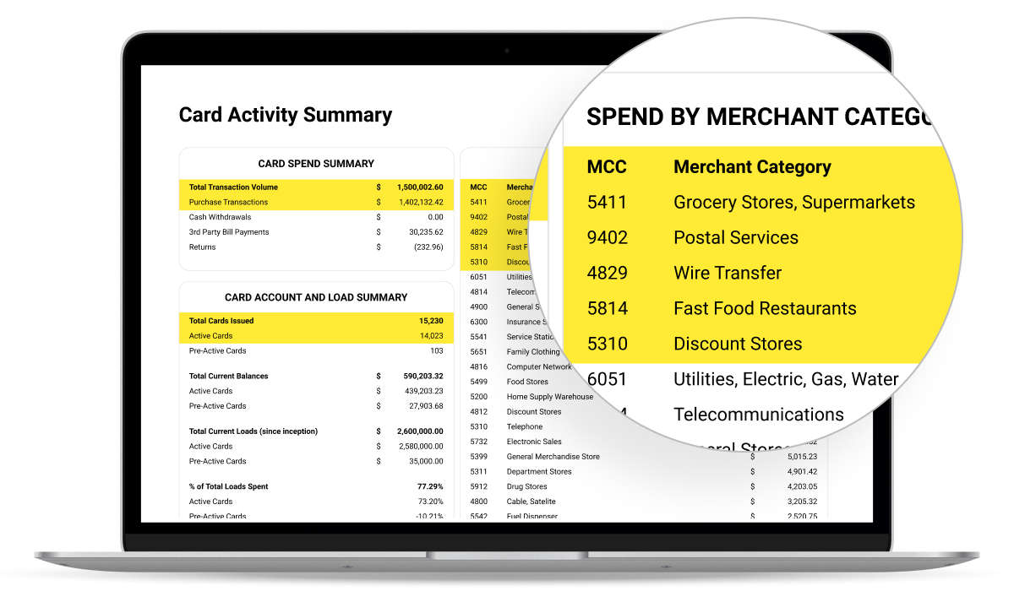
The KEY Value & Feature for Card Issuing
Reporting and Analytics of Transactions
Card activity analysis:
Aggregated level spending by Merchant Category Codes (MCC) and Merchant IDs
Anonymized data and transaction reports
Partner segmentation and hierarchy by program types (Unlimited)

Slide 14
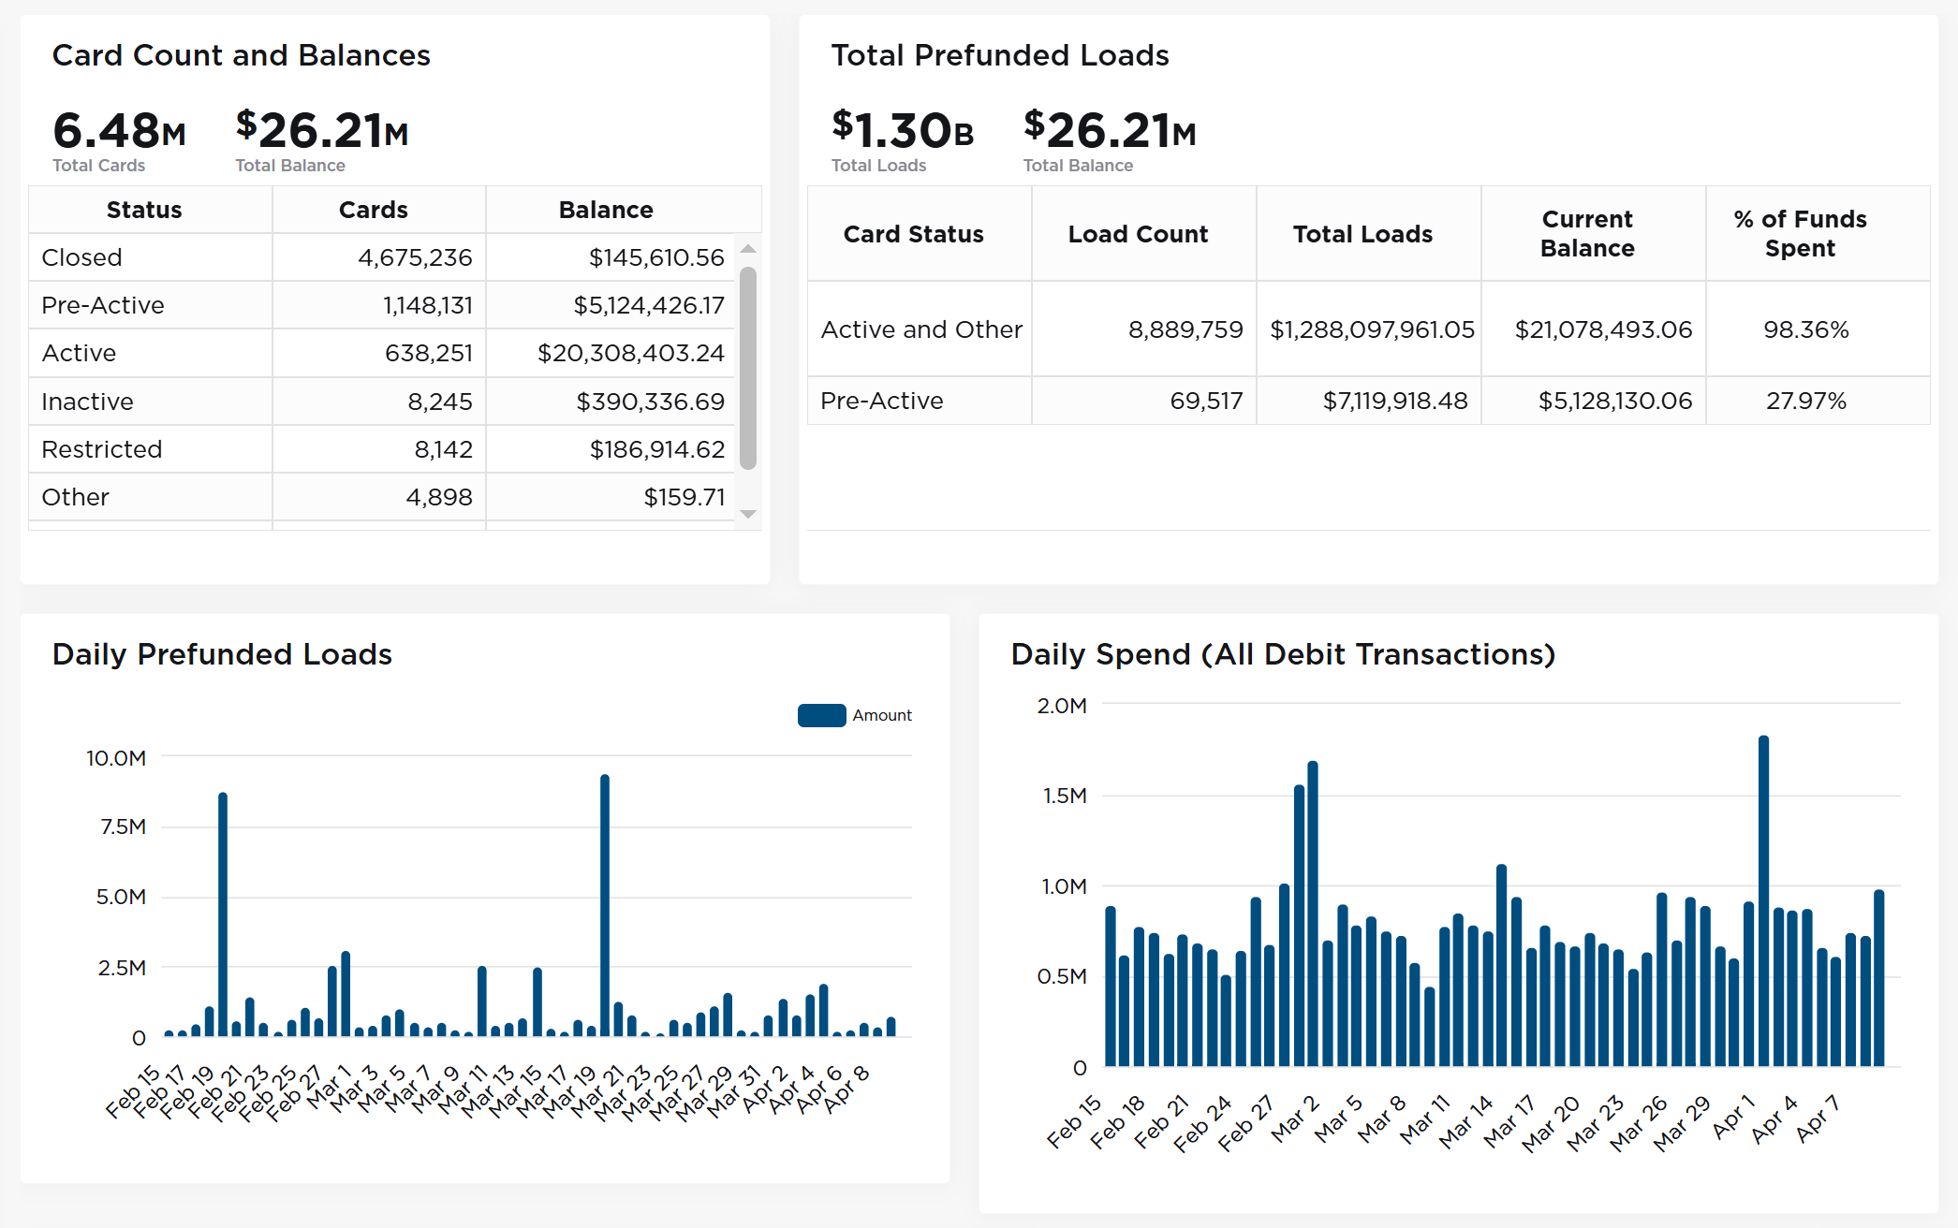
Grow Dashboard Overview

Slide 15
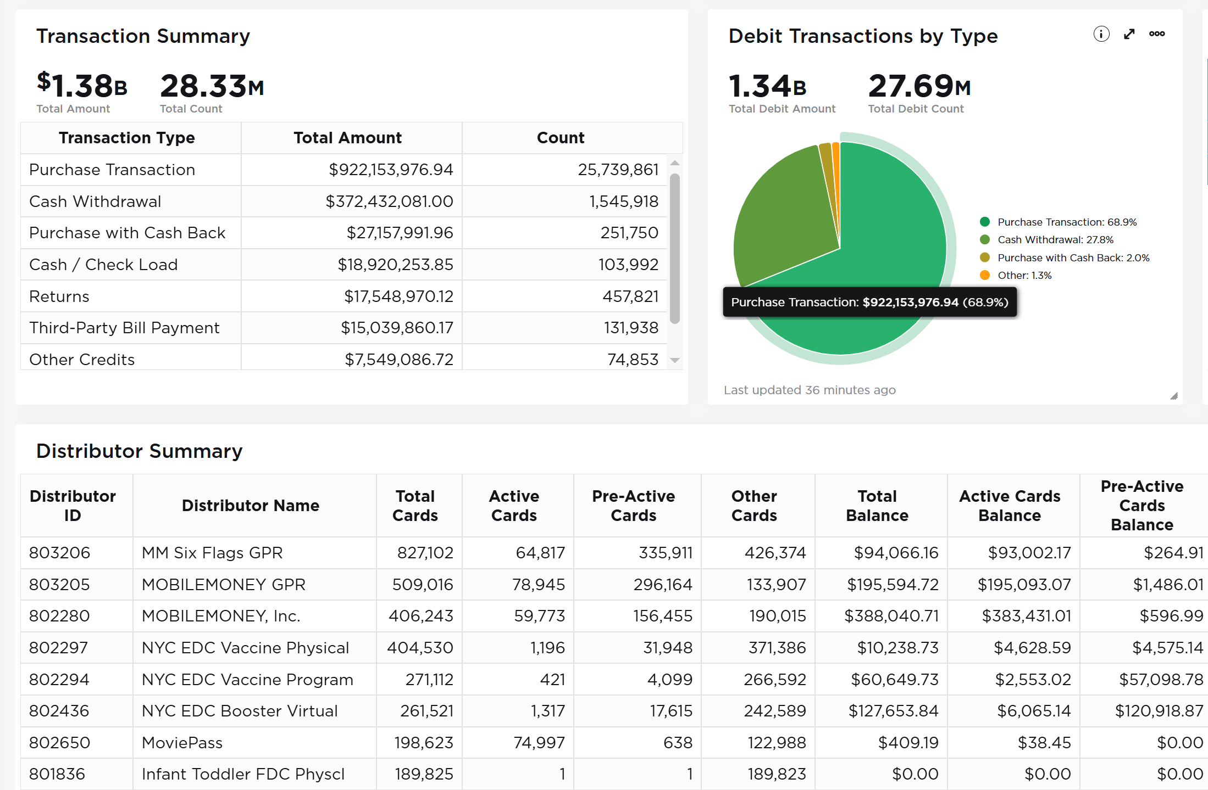

Slide 16
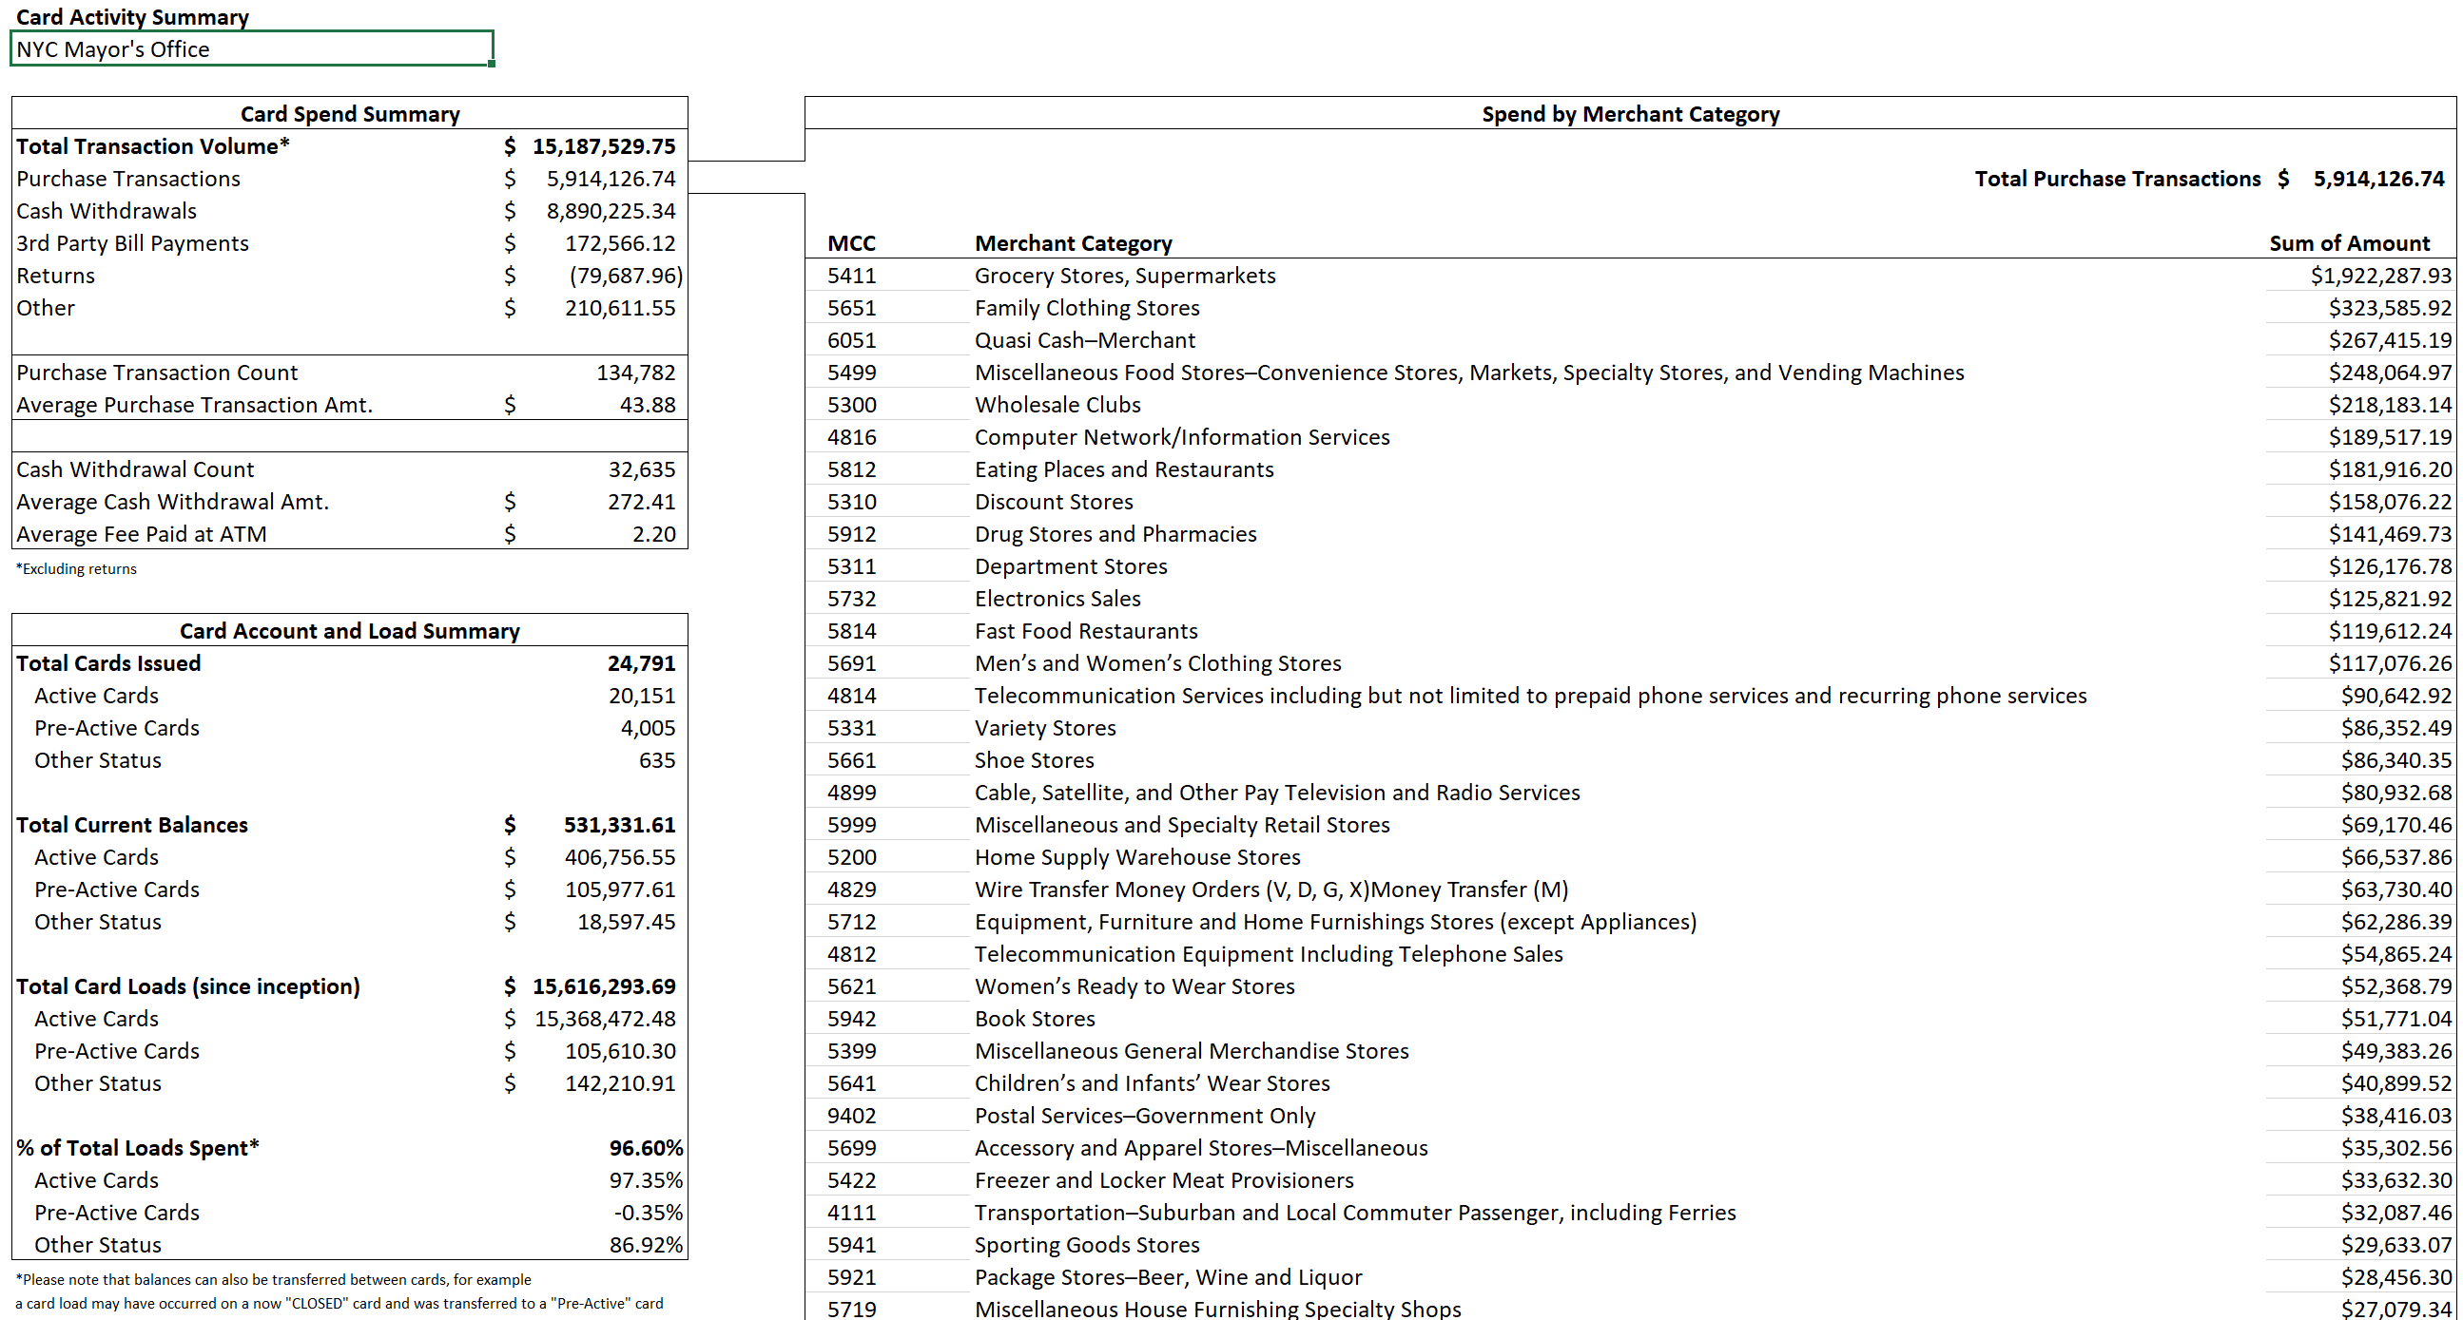
Robust reporting Capabilities:

Slide 17
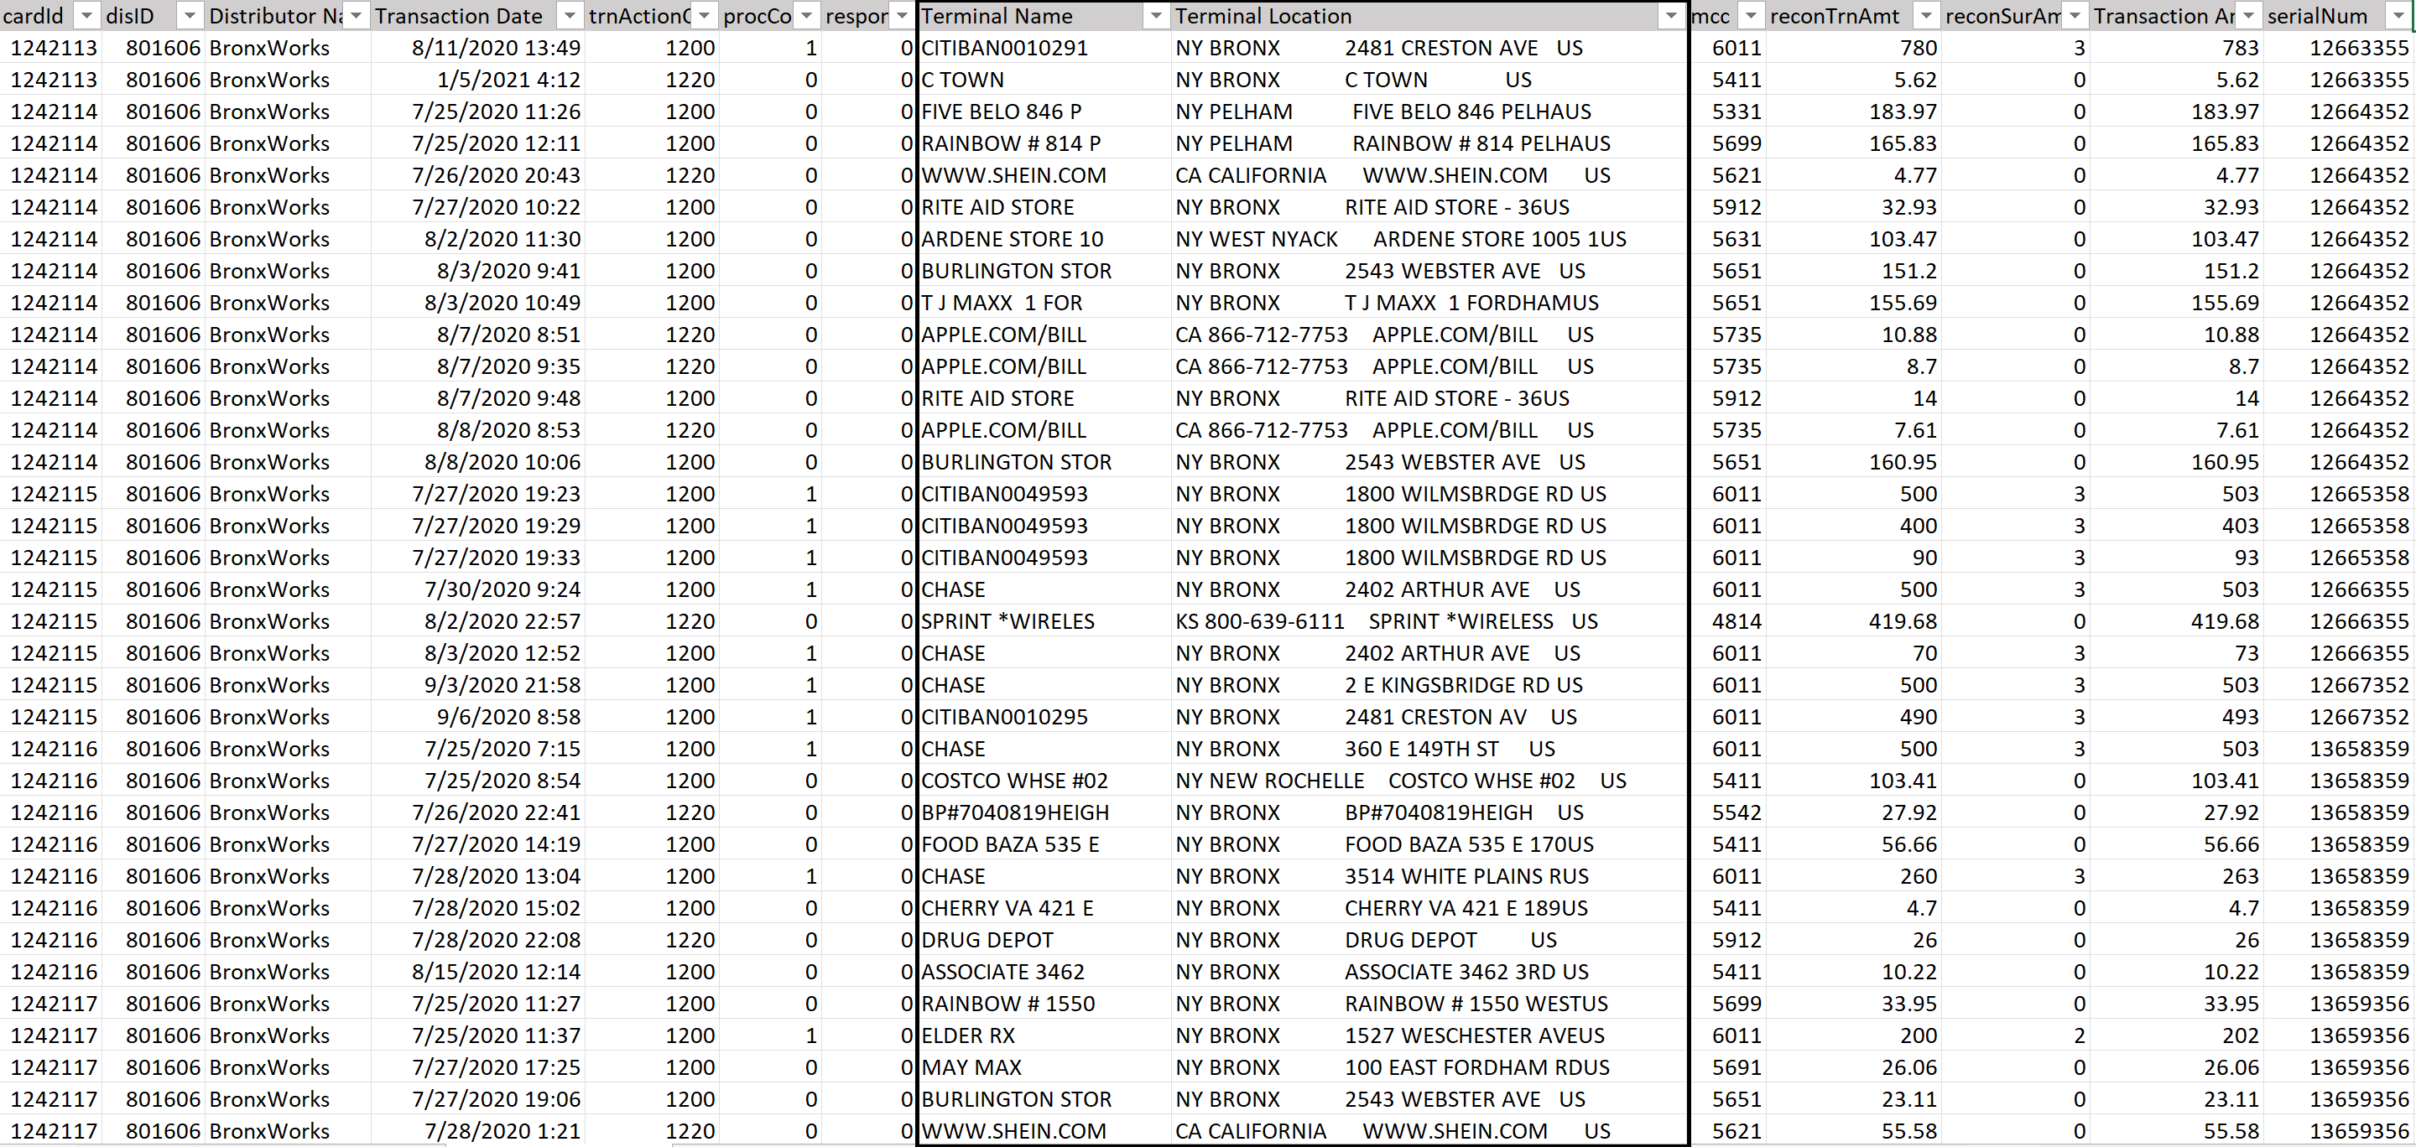
Robust reporting Capabilities:

Slide 18

Implementation Steps and Timeline
Generic Card Design (Cards shipped and loaded within 4-10 days)
1) Contact Usio with details on card program and initial card order (1-day)
2) Setup distributor account(s) for program (1-day)
3) Complete due diligence application (1-2 days, needed prior to card loading)
4) Order and deliver cards (3-10 days for deliver, depending on shipping method, real-time for virtual)
5) Deposit funds to prefunding account by wire transfer / ACH (1-day)
6) Send card loading instructions and load cards (0-30 minutes)
Custom Card Design (Cards shipped and loaded within 6-8 weeks)
Steps 1-3 same as above (2-3 days)
Design card art (1-7 days)
Receive approval on card art (7-21 days)
Order QA card package and test (3-4 days)
Order and deliver cards (3-10 days for delivery, depending on shipping method, real-time for virtual)
Deposit funds to prefunding account by wire transfer / ACH (1-day)
Send card loading instructions and load cards (0-30 minutes)

Slide 19
Closing and Q&A
“At the height of the pandemic in Los Angeles, hundreds of thousands of people were left without an income, it was clear there would be a dire and immediate need for direct financial assistance. Usio developed an innovative solution utilizing their unique technology to assist those in need. With Usio’s support, we have expanded this comprehensive program to five of the ten largest cities in the United States. We look forward to expanding our relationship with Usio as the City Possible network continues to grow.”
Miguel Gamino, EVP Enterprise Partnerships and Head of Global Cities, Mastercard.
Press Release
“New York City Economic Development Corporation is proud to work with Usio to implement this important incentive program. We have already surpassed $6mm in vaccine incentives, with a goal to distribute $20mm, and vaccinations are key to keeping New Yorkers healthy and to a strong recovery for all. We cannot have economic health without good public health, and we hope this important program will encourage more New Yorkers to get their life-saving vaccinations.”
Rachel Loeb, President & CEO, New York City Economic Development Corporation
Press Release
“Our local United Way has been proud to serve as the administrator for the 4-CT Card Program, which provides financial support for individuals who are otherwise ineligible for pandemic relief programs. In partnership with Usio and with support from 4-CT – a volunteer-led, independent non-profit entity that aims to help people who have been impacted by COVID-19 – more than 2,300 people across the state have been able to purchase food and other household necessities, clothing, healthcare, utilities, and transportation,”
Paula Gilberto, President & CEO, United Way of Central and Northeastern Connecticut
Press Release
“Usio has a strong team that’s focused on what is best for the cities and program recipients. They’ve worked hard to ensure we deliver this program quickly, maintain a consistently high service level, and make a meaningful impact on the lives of City of Phoenix residents. Usio has been a great partner for this program, and we deeply appreciate their ongoing support and efforts.”
Ben Williams, Program Manager for The Connective, an initiative of the Partnership for Economic Innovation in Arizona.
Press Release
“Usio provided us with a product that aids our efforts to increase public transit, bikeshare, and e-scooter in Oakland trips using grant funds. As our work progresses, Usio continues to be highly responsive and understanding of both our project needs and regulatory context as a public entity, including our privacy policies.”
Quinn Wallace, Parking & Mobility Division, City of Oakland, Department of Transportation
Press Release
“Our workforce is widely dispersed across Indiana, which presents many challenges in effectively managing our employees spending and its potential detrimental impact on morale. We have been looking for a robust and reliable prepaid solution that can alleviate these concerns, both for employees as well as for the Bowen Center. The Akimbo Commercial card product has all of the features and functionality we need to more efficiently and effectively manage our electronic payments without burdening our employees. The Bowen Center is excited to begin this new relationship and we firmly believe the Akimbo Commercial card will provide the flexibility and security we need.”
Jay Baumgartner, SVP of Financial Services, Bowen Center
Press Release
“After seeing what the FiCentive team had built for its own reloadable card solution, Akimbo, we knew we had found a technology driven and innovative partner. This partnership will allow Fancards to continue our mission to develop game-changing products and bring a first-class user experience to cardholders. FiCentive provides capabilities and technology that we believe makes them an industry leader.”
Greg Boggs, Fancards’ co-founder and EVP of Operations
Press Release
“This program was a success and a worthwhile investment that benefits everyone by helping to increase the city’s vaccination rate, ultimately savings lives,” said Houston Mayor Sylvester Turner. “Even with the gift card incentive program at capacity, it is still vital that more of us get vaccinated to protect ourselves and our loved ones from serious illness and death.”
Mayor Sylvester Turner, City of Houston
Press Release
“We are an innovator in applying employee motivation techniques through automated gamification-based incentive programs. The Akimbo Prepaid Mastercard will greatly improve our ability to assure incentives are efficiently distributed to a company’s employees while enabling the company to easily manage their program without the traditional burdens and limitations often associated with incentive programs.”
Darrin Briggs, President and CEO of Snowfly Performance Incentives
Press Release

Slide 20
Appendix

Slide 21
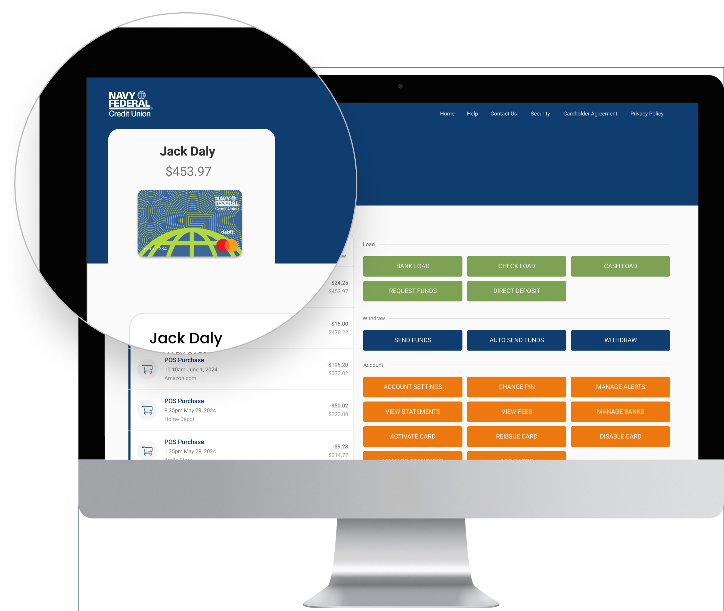
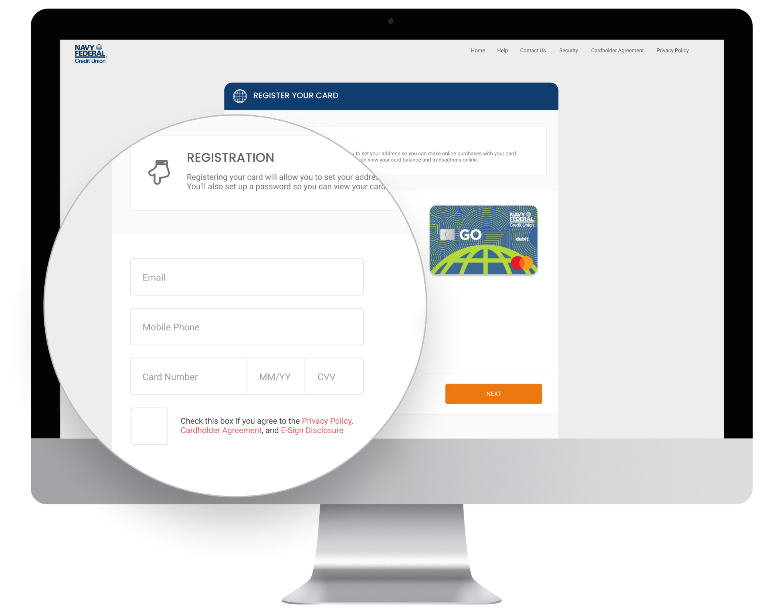
Ability to Cobrand Web and Mobile Apps

Slide 22
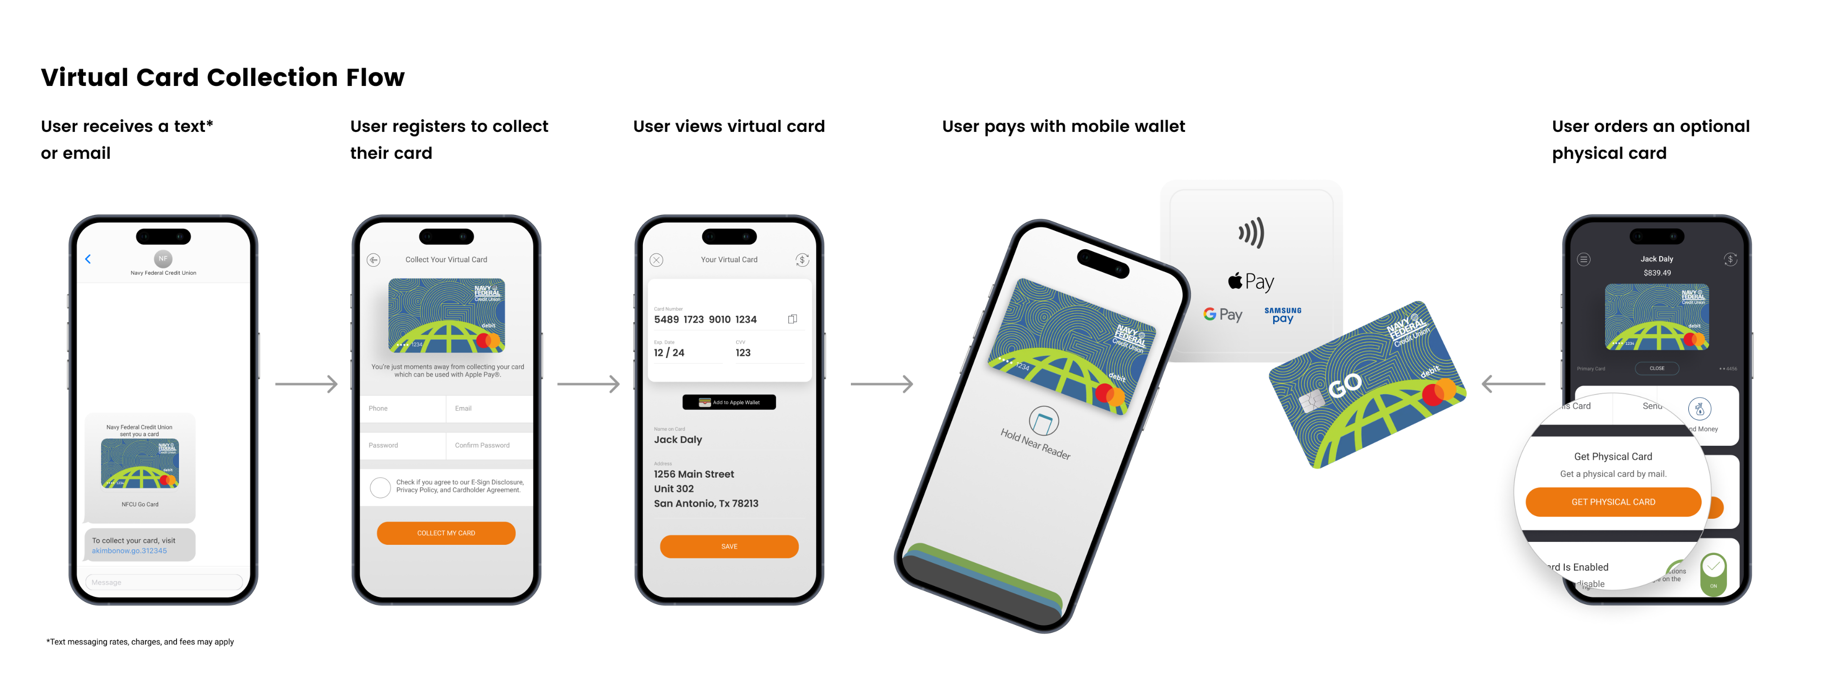
Ability to Cobrand Web and Mobile Apps

