Slide 1

Payment Facilitation: The Gift That Keeps on Giving
Nasdaq: USIO
April 2024

Slide 2
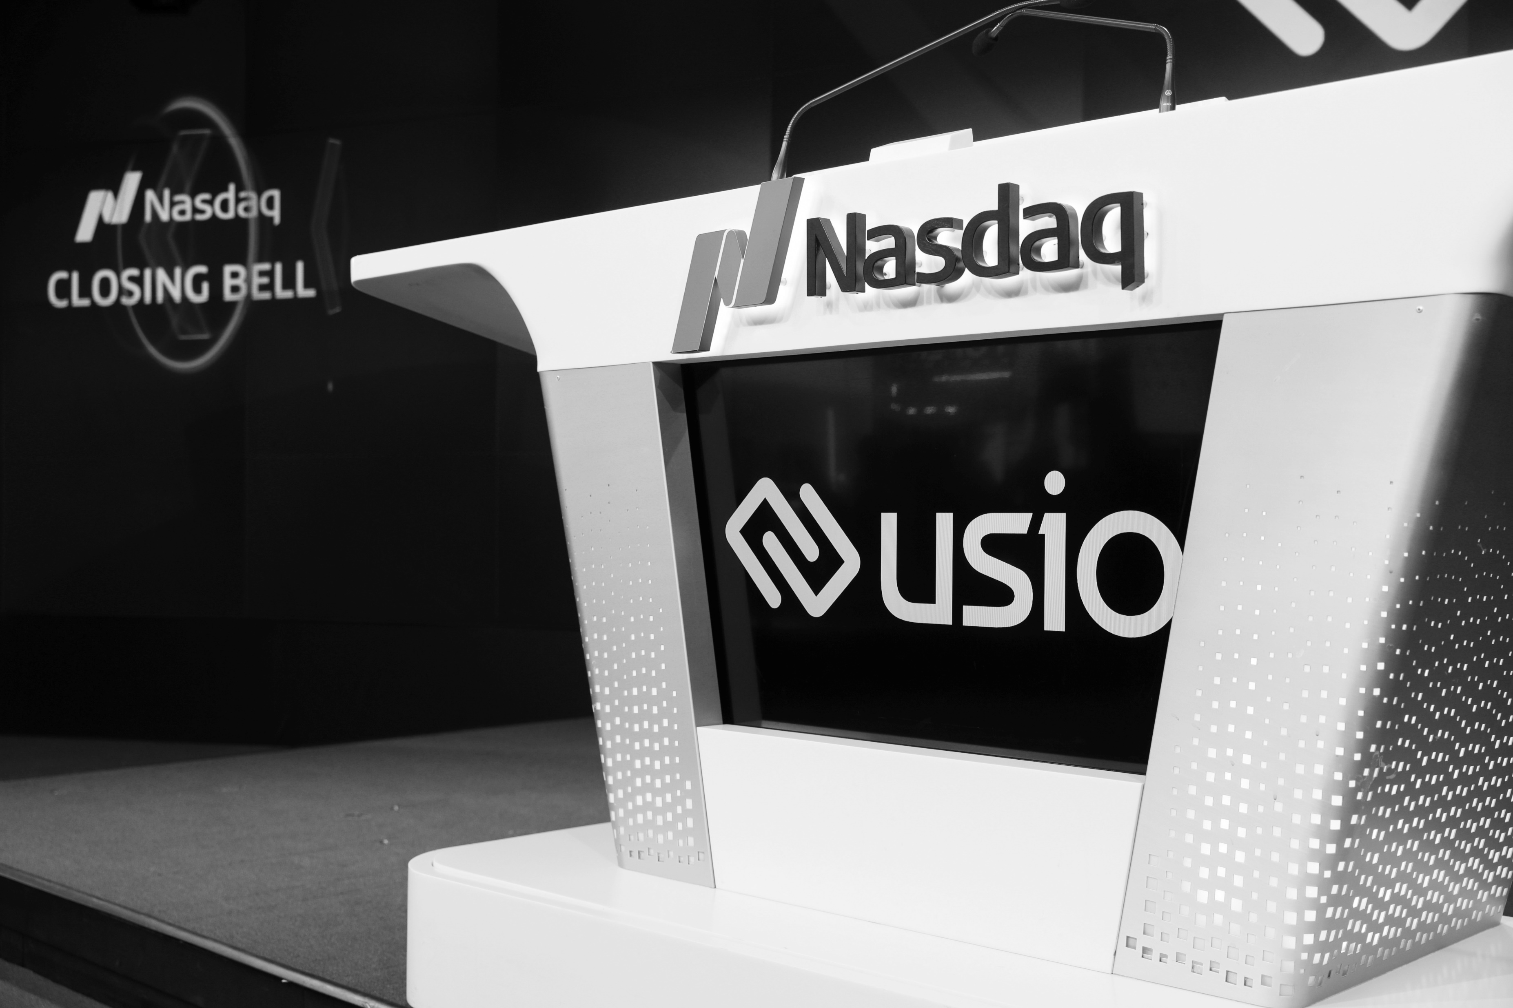
PayFac-As-A-Service
The Basics
We are the payment facilitator
  We provide onboarding, processing and settlement solutions
We enable software companies to utilize PFaaS
  while remaining largely invisible to their clients

Slide 3
Who’s it For?
ISVs (Independent Software Vendors)
Any company who creates and sells software which enables other businesses to:
  Streamline how they operate
    Accounting, Payroll, Supply Chain Management, and…
  …to sell their products and services!
    Website platform, Mobile App, SAAS Models
Nasdaq: USIO
usio.com
2

Slide 4
Why You’re Interested
Top of Funnel Sales Approach:
  One relationship can equal thousands of merchant accounts
  “The gift that keeps on giving”
Nasdaq: USIO
usio.com
2

Slide 5
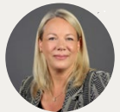
“PFaaS platforms are not just a trend, but a fundamental shift in how the payment industry operates.”
-Jennifer Marriner EVP, Acceptance Solutions, Mastercard – February 2025
The future of payment facilitation: The rise of PayFac as a Service

Slide 6
Back in the ‘90s
Integrated Payments: ISVs would send their clients “over the fence’ to setup a merchant account
little control of the merchant experience
Small or zero residual payments
No white label option
Limited customization
Nasdaq: USIO
usio.com
2

Slide 7
In the early 2000’s
ISVs now had the option to become a payment facilitator, and to white-label their own payment solution
Years to develop and millions of $
Reserved for large companies
The shift I saw
Nasdaq: USIO
usio.com
2

Slide 8
Today
ISVs can utilize Payment Facilitation-As-a-Service
embed, white-label, and manage their own payment program at a fraction of the cost
  Weeks to integrate, zero startup cost, and no need become an expert in payments
Nasdaq: USIO
usio.com
2

Slide 9
PFaaS Model
 |  |  | Master MID
Software 1 |  |  |  | Software 2
MID 1 | MID 2 | MID 3 |  | MID 1 | MID 2 | MID 3
Nasdaq: USIO
usio.com
2

Slide 10
Why would an ISV be interested in PFaaS?
Control of Client Experience
    -Who they talk to
    -How the app is sent
    -Client interaction (reputation)
Automated /Instant On-Boarding
Information at hand
  Direct access to all sub-merchant accounts
Company Valuation (capital raises, or to sell / go public)
Rates
Fees (think Card Connect)
Contract Terms

Slide 11
Why would an ISV be interested in Usio over the competition?
Live merchant support (many PayFac’s require their ISVs to handle level I & II merchant support requiring them to incur costs (reallocating resources, training staff, hiring new staff, etc)
Live development support – I doubt there is another PayFac that can offer direct support from the person who wrote their APIs
Product Suite
Single API
No pre-built box making customization virtually limitless
Systems built & managed in-house (boarding, ACH, etc)

Slide 12
Why would an ISV be interested in Usio over the competition?
Revenue Share – many large companies, like Stripe, do not share in the revenue, despite charging ISV’s sub-merchants an exorbitant rate. If they do share, it’s only for very large ISVs and the share rarely exceeds 50%
No Staged Underwriting – larger companies tend to utilize this to get credentials out quickly. However, it can lead to a merchant’s funds being held, and accounts being shut down without notice
Nasdaq: USIO
usio.com
2

Slide 13
Who is our competition?
Stripe, Shift4, Ayden, Payrix / WorldPay, Card Pointe / Card Connect, Nuvei, Pay Junction, Fortis, Tilled, and many more
Nasdaq: USIO
usio.com
2

Slide 14
ROLE PLAY: After School Software
Volunteer to be the ISV?
Scenario:
You’ve just created an application
Your clients are requesting an
integrated payment solution
You’ve started integrating to Stripe, but are
not receiving the support
You’re attending a FinTech conference to
explore your options and you come across the
Usio booth…
Nasdaq: USIO
usio.com
2

Slide 15
My Examples
Eternal Interactive – Trail Life
DCS - Houston County Sanitation, AL
Sports Camp Central
  All lowered interchange
Nasdaq: USIO
usio.com
2

Slide 16
Notes
Long road so still need supplemental prospecting on large, individual merchant accounts – C.A.
They integrate to us. Most of the time needed is for them to develop or enhance their software to facilitate payments (front-end development). Once ready, the time to integrate to Usio can be a matter of weeks.
Seek dev shop relationships as they build software that often needs a payment solution…and we pay!

Slide 17
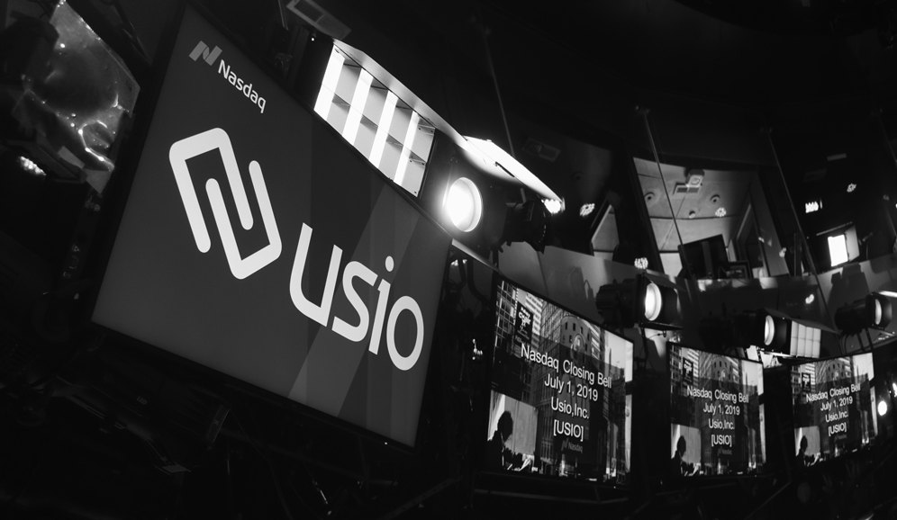

Q&A
Nasdaq: USIO
usio.com
3

Slide 18
PAYMENT FACILITATION
HOW WE MAKE MONEY
Payment Facilitation (PayFac) is the latest innovation in merchant acquiring, providing frictionless merchant onboarding, enrollment and automated risk/underwriting procedures - which have traditionally been very manual processes - to provide for mass adoption and scale in short order by way of a leveraged distribution model (one-to-many). Our differentiated go-to-market strategy creates loyalty and enhances customer value of the Integrated Software Vendors (ISVs) we serve. ISVs are now able to monetize payments flowing through their software applications, turning payments from a cost center to a revenue generating business unit.
*
30%
REVENUE SHARED WITH ISV
GROSS MARGIN
50%
OF GROSS NET MARGIN
34%
25%
15%
OF 2023 REVENUE
(includes all card)
PAYFAC
REVENUE GROWTH
2023 VS 2022
TO USIO
*Retail pricing isn’t fixed. Pricing varies based on ISV/vertical. Not indicative of all ISVs.
Nasdaq: USIO
usio.com
9

Slide 19
Chris Ross
Director, Partnership Development
m. 970-420-5903
e. chris.ross@usio.com

