Slide 1


WELCOME
How SEO Fuels Usio Sales

Slide 2



WHAT IS SEO
93% of online experiences start with a search engine
SEO (Search Engine Optimization) = optimizing our sites to rank higher on Google. For example, if someone is searching “integrated payment solutions” via Google. We want Usio.com to be on page one.
It's about visibility, credibility, and converting traffic into leads
Web Search
Usio.com
Lead
Source: Harvard Business School

Slide 3
WHY SEO MATTERS
SEO leads are warm: They searched *for solutions*, not the other way around
They're usually problem-aware and *solution-seeking*
Shorter sales cycles, better conversion rates
Inbound leads tend to close at significantly higher rates because prospects are already looking for a solution and are further down the sales funnel.
SEO (Inbound) Lead Close Rates: 14% – 25%
  Cold Average conversion rate to lead is 2% – 5%
Source: Harvard Business School

Slide 4

Source: Usio Google Analytics
OUR STRATEGY
2025 RESULTS
What We’re Doing Behind the Scenes
Keyword targeting (e.g., “integrated payment solution”, PayFac-as-a-Service, Prepaid Card Issuing, Bill Print & Mail, etc)
On-page optimization (content, blogs, metadata)
Technical SEO (site speed, mobile, backlinks)
Local SEO (Google Business Profiles for partner programs)
Every blog, every backlink, every optimized page helps us rank
We’re not just writing content—we’re engineering discovery

Slide 5
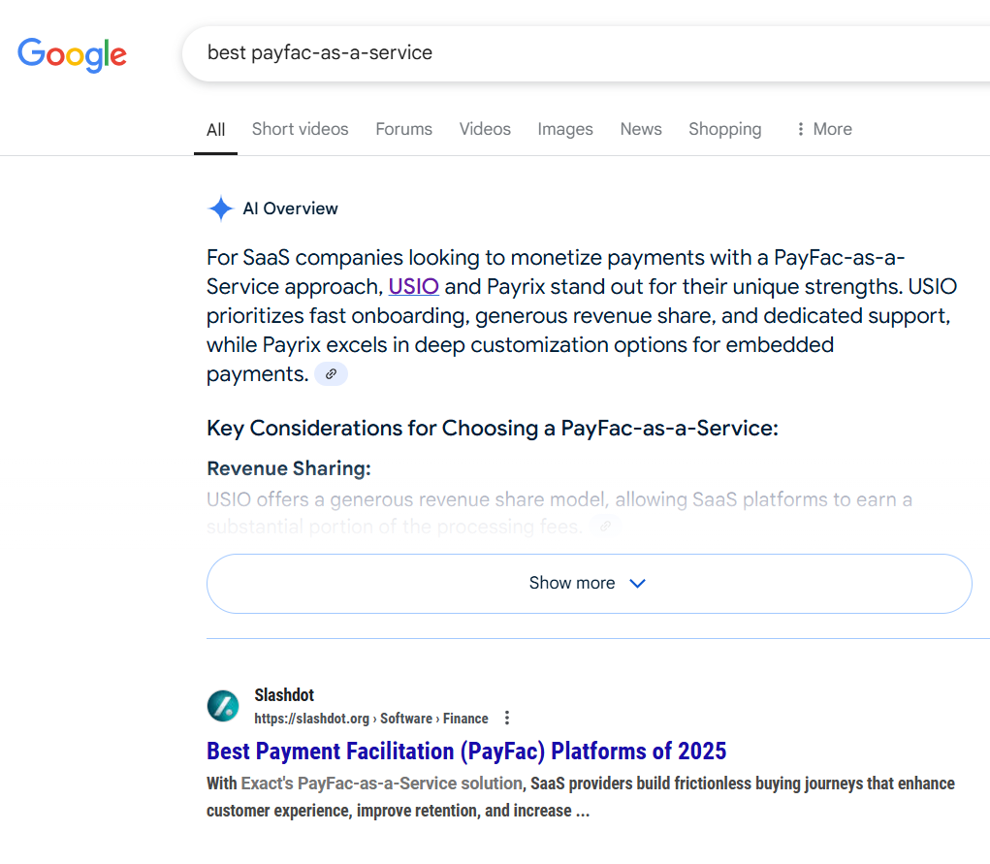

RESULTS
EduTrak Software
Brent Kauth
Search Intent: best payfac-as-a-service
Search Date: April 8, 2025
Lead Received & Sent to Josh M.: April 8, 2025
Web Search
Usio.com
Lead

Slide 6

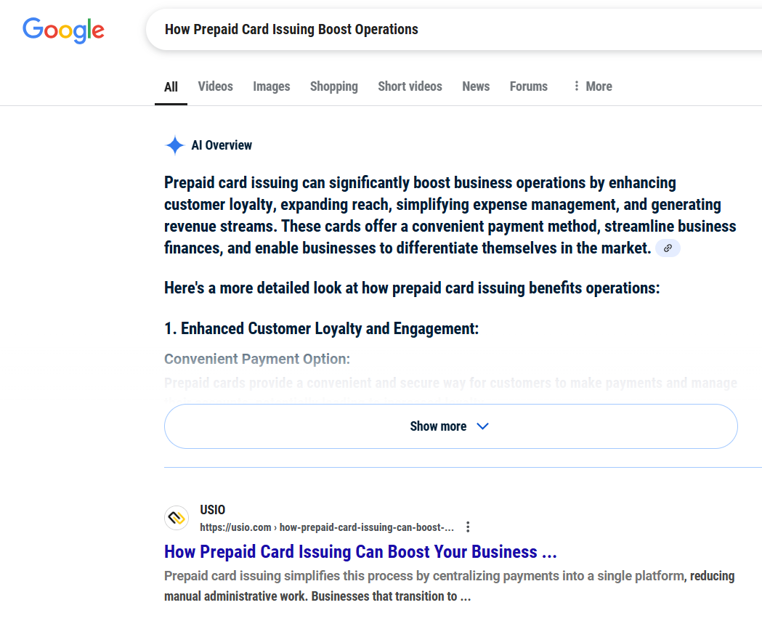
RESULTS
UrbanBuzz
Trevor Smith
Search Intent: How Prepaid Card
Issuing Boost Operations
Search Date: April 4, 2025
Lead Received & Sent to Steve P:
April 4, 2025
Web Search
Usio.com
Lead

Slide 7

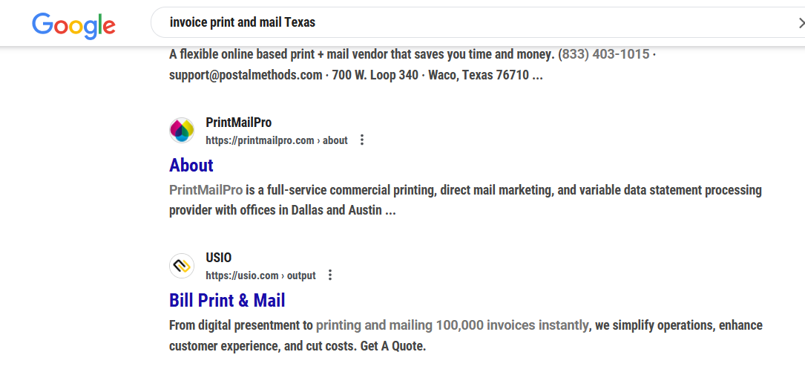
RESULTS
City of Uvalde
Marisa Arreola
Search Intent: Invoice Print & Mail Texas
Search Date: March 25, 2025
Lead Received & Sent to Frank T.:
March 25, 2025
Web Search
Usio.com
Lead

Slide 8
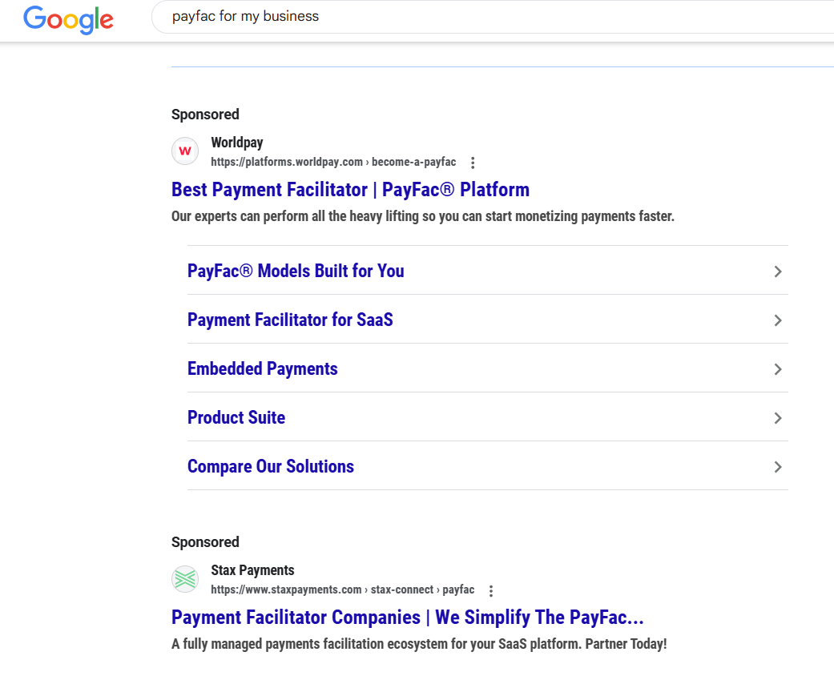
RESULTS
Paid Advertising results Show up as SPONSORED. With the example on the right, we estimate that Worldpay & Stax Payments are paying between $125 - $250 per click for top placement on the search term “Payfac”
How much did Usio spend? Nothing. The ROAS Return on Ad Spend is 100%
Usio results are all organic. The work marketing as done over the last year is beginning to pay off.

Slide 9



OUR STRATEGY
Top-Performing Usio SEO Pages (AKA Blogs)
Best Stripe Alternative
What Are Prepaid Card Users Buying?
How To Incorporate ACH into Your Payment Strategy

Slide 10

BOTTOM
LINE
We’re winning the digital real estate game.

Slide 11
QUIZ
What % of online experiences start with a search engine?

