Slide 1


Acquiring
Merchant Services

Slide 2


Payment
Facilitation
ACH/RCC/RTP
Products
Credit Card
Pinless Debit

Slide 3
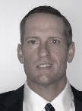








JULIE
Villarreal
VP Payment Acceptance
CLAYTON
Clark
Director
Sales Operations
MARIE
Arellano
Account Manager
GIA
Gant
Merchant Success Rep
JAKE
Bamford
Account Manager
KANDY
Burrows
Merchant Success Manager
LAUREN
Cortez
Account Manager
The Team

Slide 4





Merchant Services
Sales Operations
Account Managers
Support & Service
CRM-Hubspot/Lead Facilitation
Opportunity Vetting
  Deal Solutioning & Pricing
  Contractual Fulfillment
  Tech Calls
Expedite Enrollment and Onboarding
Fulfill Risk Requirements
Welcome Emails
Work closely with backend processors
Maintain Partner Relationships
  Understand client needs and goals
  Monitor Integration Needs
  Provide Product Training and Reporting
Support ISVs/Merchants
Monitor accounts/fraudulent activity
Monitor Overage & Declines Reports
ACH Returns/Settlement Holds
Resolve Processing Issues
Account Updates/Bank changes
Pinless Debit Onboarding
Chargebacks
POA (Proof of Authorization)
Terminal Device Fulfillment
ONE
THREE
TWO

Slide 5
Value Added Services
Sales Operations
24/7 Support
Expert Product Knowledge (CPPs)
Cross Departmental Collaboration – Integrations/Risk
Downstream Partner Engagement – (Repay, Worldpay, TPB)
Fast Response and Resolution Times
Personalized Support w/Account Managers increasing Retention rates
Expedited Onboarding & System Training

Slide 6
YOY Market Growth – Payment Acceptance/All Products
67%
59%
55%
54%
36%

Slide 7
Commission Growth 2021-2024
Payfac Partners
+24%
+81%
+28%
$ 616,513.10 | $ 790,186.79 | $ 1,431,502.49 | $1,767,863.00

Slide 8
Commission Growth 2021-2024
Non Payfac - PDL Partners/Agents
+21%
+17%
+13%
2021 2022 2023 2024
$ 1,802,573 $ 2,031,274 $ 2,380,466 $ 2,881,052

Slide 9









Diverse Industry Verticals

Slide 10
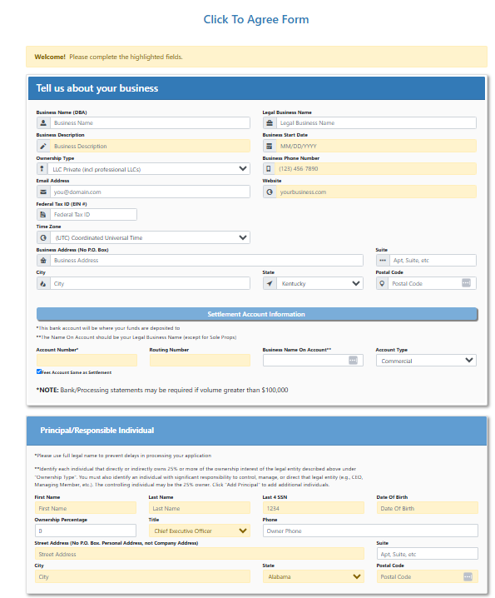
Current Payment Acceptance - Merchant Onboarding
Single page electronic application
  One application for multiple products (CCard, ACH/RCC/RTP, Pinless)
No documentation required – Payfac merchants
Automated KYC process
  TINcheck
  People Search
  Mastercard MATCH
  OFAC
  ID Verification (EDD)
Same day approval upon successful KYC process – Payfac merchants
Additional due diligence required if KYC failure - Risk
Once approved – API credentials sent to merchant, can begin taking payments
Welcome emails and follow up communication from Acct Managers
Admin Enrollment Portal for ISVs to enter and view
submerchant information and statuses of application

Slide 11
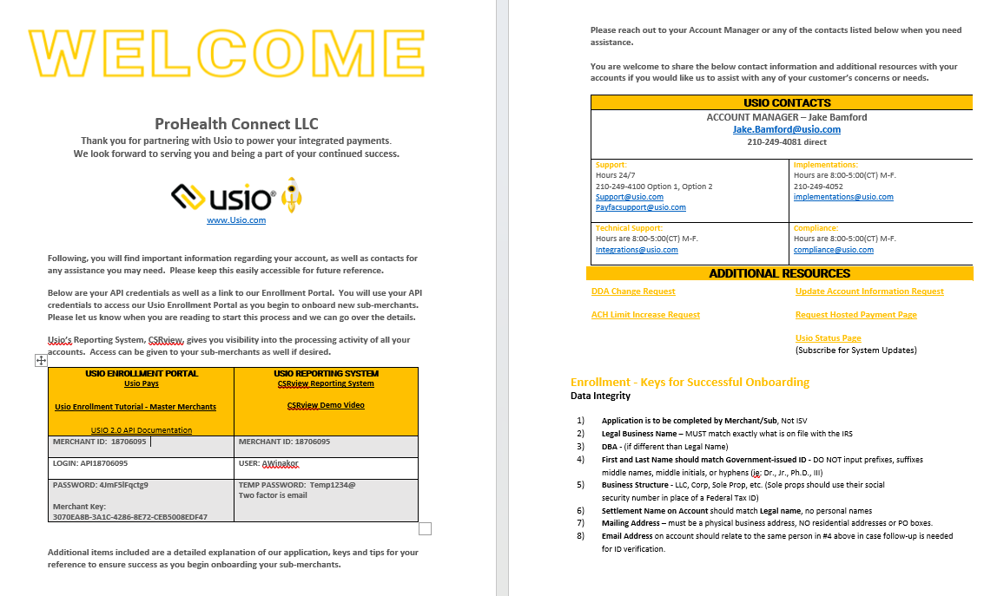

Slide 12
Payment Acceptance Dev Priorities
Billserv 2.0 – launching 6/1
Unified Enrollment
Phase 1 – Card Issuing
Enrollment will kick off from DCP and once the customer is approved, the customer data
will be copied into enrollment and sent to Card Services to setup the merchant in their systems
Phase 2 – Merchant Services
New piece will be replacing our current click to agree section
Agreements/Terms will be sent via Docusign
Future Phases – ability to add products, create multiple merchant accounts
with one KYC
Unified Prefunding
Phase 1 will include the ability to transfer funds between prefunding ledgers
with the bank transfers happening automatically in the background

Slide 13
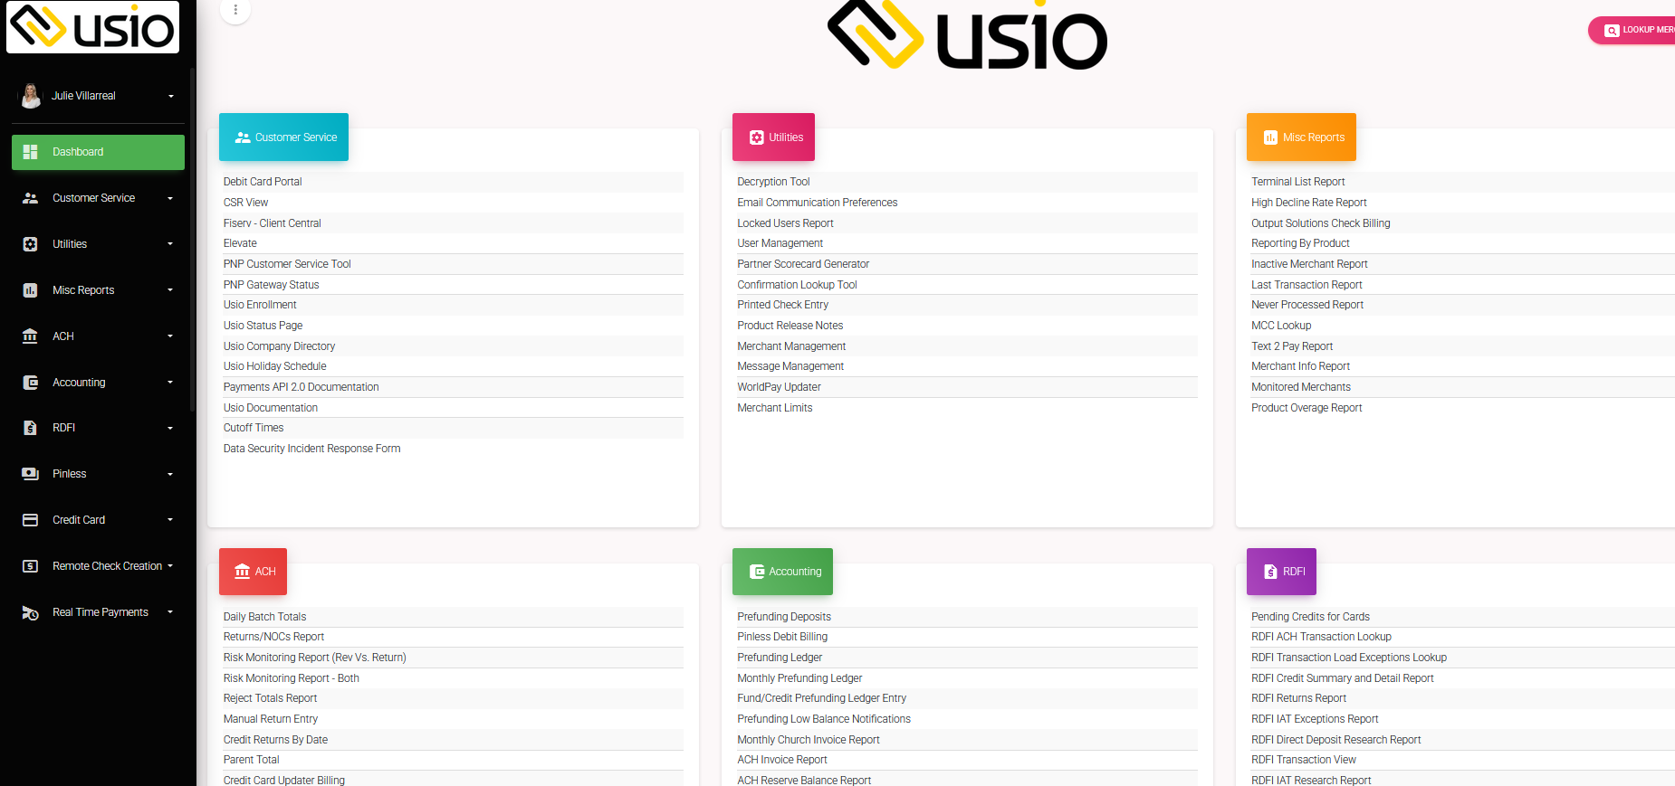
https://hub.usiopay.com/

