Slide 1




The wild world of payment acronyms

Slide 2

📊 Usio ACH Processing - 10 Minutes
🧭 Usio RTP Processing - 5 Minutes
🎨 Usio RCC Processing - 5 Minutes
Today's
Topics

Slide 3


ACH Processing!

Slide 4


🤑 ACH (Automated Clearing House) is an electronic network for financial transactions, think bank account to bank account, in the United States
🤑 Managed and regulated by Nacha (National Automated Clearing House Association)
🤑 Established in 1974 (50 Years!)
🤑 Handles billions of transactions annually
🤑 ACH continues to grow year over year especially same day transactions
🤑 ACH is the #1 choice for payroll, government benefits, tax refunds, and pensions
What is ACH?

Slide 5
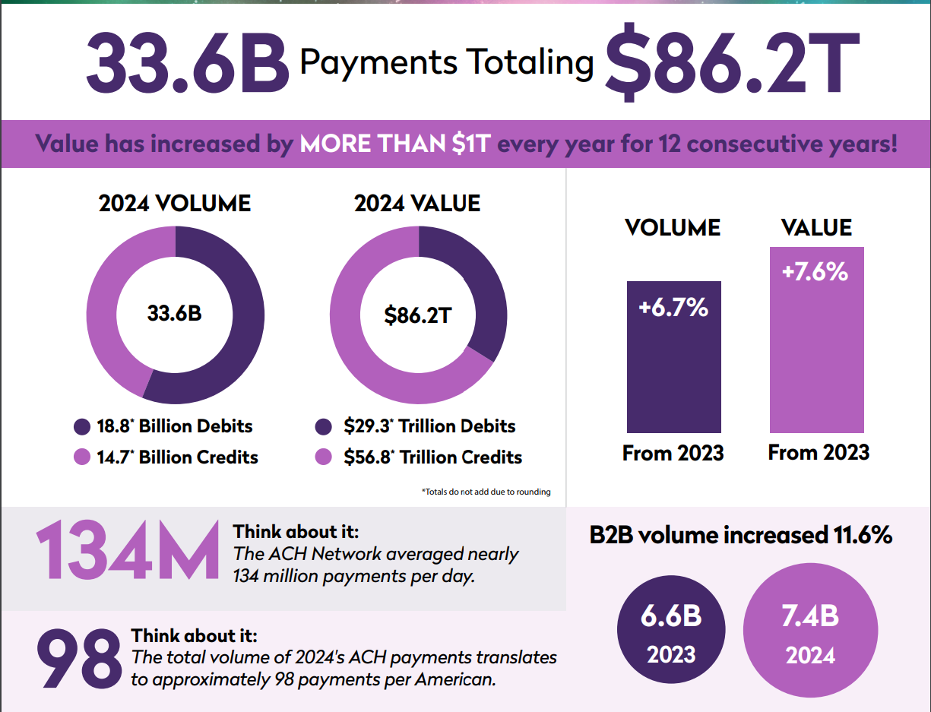
2024 Industry Statistics
Nacha 2024 Statistics
Usio 2024 ACH Statistics
Debits | Credits | Totals
Transactions | Transactions
14.2M | 2.4M | 16.6M
Dollars | Dollars
$3.1B | $2.4B | $5.5B

Slide 6

🤑 Typical ACH debit & credit pricing ranges from $0.50 to $0.10
  Larry, Clayton or myself are happy to help with pricing questions
🤑 Returns (The high wire act) typical pricing $1.00 for normal returns & $5.00 for Unauthorized returns
  Returns are great for profit, but they can also get a merchant in trouble, and if chronic can get them terminated.
🤑 ACH is not real-time and is a batch process
🤑 All “Credits” require Pre-Funding
Usio ACH Things to Consider

Slide 7

Usio Primary ACH Customers TODAY
Subprime lenders – State & Tribal lenders
Collections
Mortgage & Hard Money lenders
Clients with frequent funding requirements (ClassWallet)
Akimbo Card
Future Usio ACH Customers
Disbursement opportunities including escheatment
Loading digital wallets – bank linked transfers like Venmo & PayPal
Crypto currency fiat on-ramps
Continued ISV pursuits with payment requirements
Any Merchant with a recurring payment requirement – utilities, mortgages, insurance – to name a few
Usio ACH Business

Slide 8
🤑 Ubiquitous payment option
🤑 Low-cost alternative to Credit & Debit cards
🤑 Usio has built a reputation of best-in-class support and Technology
🤑 Very high margin product (Louis loves this)
🤑 Usio’s multiple bank sponsorships and trust in the industry
🤑 Usio is one of a few Nacha Certified providers
Why Usio ACH?

Slide 9

You can spell ACH
It is a low cost, high margin product that every client should use
Usio is one of 11 or so third-party senders out of over 11,000 that is Nacha Certified
Usio has multiple ACH banking sponsors
Usio tech stack is second to none in the ACH space
Usio provides white glove onboarding and support services
Key Takeaways

Slide 10
RTP Processing!

Slide 11
🤑 RTP (Real Time Payments) is an electronic network that allows instant transfers between US bank accounts
🤑 Launched in 2017 by The Clearing House (relatively new to Usio as we just launched this year)
🤑 Operates 24/7/365 – nights, weekends & holidays
🤑 Irrevocable: Once sent can’t be reversed
🤑 Funds settle in seconds
What is RTP?

Slide 12
🤑 Not 100% bank coverage (I’ve read 350 banks participate. Small banks and FI’s will be slower to adopt)
🤑 More expensive than ACH
🤑 Push only, even though there is an RFP (Request For Payment) option
🤑 All transactions require pre-funding
🤑 More expensive option to ACH Typically priced at $0.95 - $0.75
Usio RTP Things to Consider

Slide 13
Usio Primary RTP Customers TODAY
Subprime lenders – State & Tribal lenders
Funding loans
Future Usio ACH Customers
Disbursement opportunities including escheatment
Accounts Payable ISV’s with frequent vendor payments
On Demand pay for Gig workers
Clients with frequent funding requirements like (ClassWallet)
Usio RTP Business

Slide 14
🤑 Demonstrates Usio’s commitment to cutting edge payment solutions
🤑 Lower cost funding option compared to PinLess Debit for our lenders to instantly fund loans (downside is coverage)
🤑 Usio has built a reputation of best-in-class support and Technology for all products
🤑 Access via our API 2.0 with different end point – makes for easy integration for our clients
Why Usio RTP?

Slide 15
You can spell RTP
It is a lower cost, good margin product that will continue to gain market share
Customers are already familiar with API 2.0 and this is easy to add as an option
Usio has a single bank sponsor for RTP
Could help business with cash flow, allowing payments at the last minute
Usio provides white glove onboarding and support services
Key Takeaways

Slide 16
RCC Processing!

Slide 17
🤑 RCC (Remote Check Capture) lets businesses initiate a check payment from a customer account without a physical check
🤑 Customers authorize the transaction verbally or in writing
🤑 Usio physically creates a digital check image for storage (output services)
🤑 For collections, RCC is a lifesaver. It simplifies one-time recoveries and reduces excuses or delays from customers
What is RCC?

Slide 18
🤑 Typical RCC pricing ranges from $0.50 to $1.00
🤑 Returns typical pricing $2.50 for normal returns & $7.50 for Unauthorized returns
  Returns are typically very high with RCC and are high margin not subject to Nacha regs
🤑 Almost exclusively used by our sub-prime lenders that have gotten into trouble with ACH returns
🤑 Currently we have one bank sponsor for RCC
🤑 Merchants must retain record of Authorization for 2 years
Usio RCC Things to Consider

Slide 19
🤑 Excellent last resort for collections
🤑 Single API 2.0 makes integration a breeze
🤑 Usio best-in-class support and technology
🤑 Not many of our competitors offer RCC as an option
Why Usio RCC?

Slide 20
You can spell RCC
Excellent margin product
Clients using RCC are sub-prime lenders, exclusively at this point
Usio tech stack and single API integration
Usio provides white glove onboarding and support services
Good opportunity for growth with other lender’s & collection's clients
Key Takeaways

Slide 21

Let’s Go!

